Slide 1


Community Officer Induction 2026-27

Slide 2
Welcome and Congratulations!
Training delivered by Olivia Davies, President and Fran Hailey, Community Engagement Coordinator.
STUDENT LEADER CONFERENCE

Slide 3
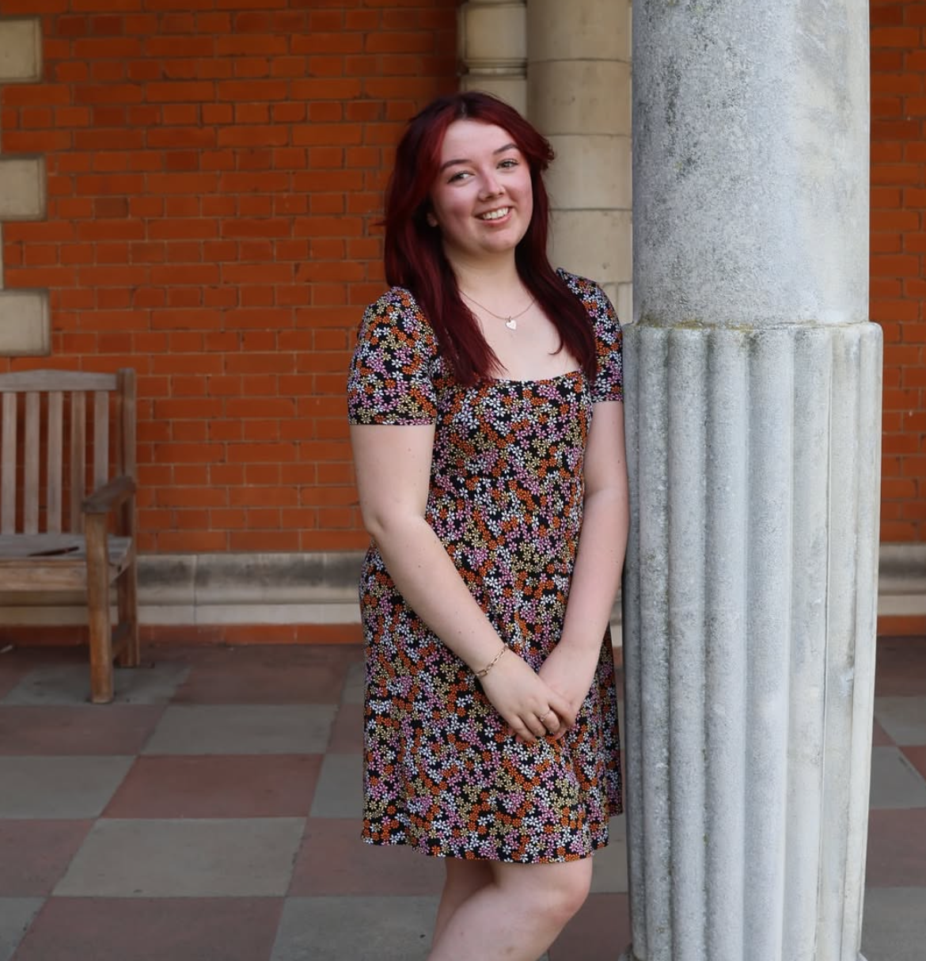
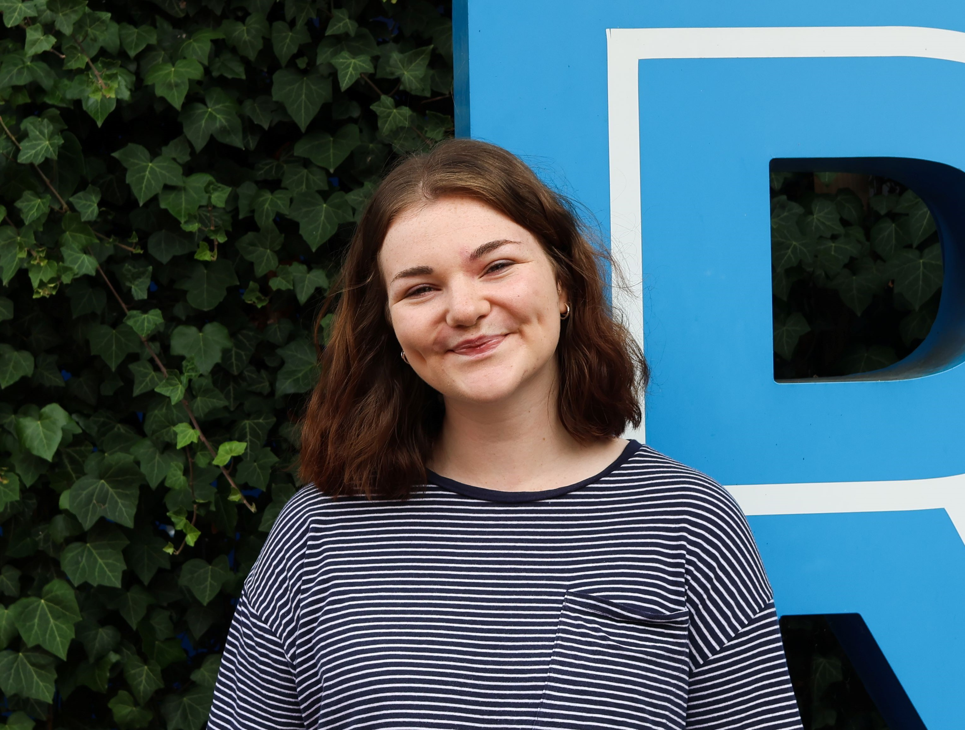

Introductions
Your turn: Name, degree, Community Officer position and fun fact.
STUDENT LEADER CONFERENCE

Slide 4
1. Who and what are the Communities
5. Community Officer Teams Channel
What we’ll cover
All information can be found in the Postgraduate and Inclusion Communities handbook, your job description document or your handover.
Further, your 121’s with Fran can go over any information and you’re more than welcome to book a meeting with Fran during the summer.
2. Memberships
6. Training & Expectations
3. Funding
7. Community Councils
4. Support
8. Excepted Democratic Engagement
STUDENT LEADER CONFERENCE

Slide 5
Who and what are the Communities
STUDENT LEADER CONFERENCE

Slide 6
Who and what are the Communities
11 Autonomous bodies supported by the RHSU Constitution.
Responsible for working with the SU to secure the interest and rights of students.
Coordinators of activities, events and campaigns e.g., Liberation History Months.
Supporters of Student Group activities.
Supporters of the Sabbatical Officer team in Priority 8 and projects relating to their work stream.
Inclusion Communities are led by Community Officers – that's you!
In short, you are here to improve your Community at Royal Holloway.
STUDENT LEADER CONFERENCE

Slide 7
Who and what are the Communities
Inclusion:
Black & Global Majority Students.
Women Students.
LGBT+ Students.
Mature Students.
Parent & Carer Student.
Commuting Students.
International Students.
Students of Faith.
Disabled Students.
Postgraduate:
PGR Students.
PGT Students.
STUDENT LEADER CONFERENCE

Slide 8
Memberships
STUDENT LEADER CONFERENCE

Slide 9
Memberships
To make it easier for everyone to get involved, we've created one simple membership sign-up form. You can find it on every Community Officer’s webpage, as well as on the main Community Officer page on the RHSU website. (We’ll update the form for 2026/27 and have it ready before September 2026).
This form is the easiest way to join a community - it’s part of the self-definition process, which helps break down any barriers to joining an inclusion community. Once Students sign up, they'll be added to your Community Officer’s member list, so they can be kept in the loop, added to their network, and included in any updates or activities.
The Campaigns Assistant will update these membership lists every week, so Community Officers always have the latest info. You’ll find your community’s list in the file called ‘Community List’ on your private Teams channel. Because this is a new form, even if students were part of a community last year, students will need to sign up again.
To stay in touch and hear about what’s going on, keep an eye on your Community Officer’s Gmail account (ending in @royalholloway.su) and their Instagram account (which starts with @rhsu). And don’t forget, you and students will still need to self-identify as part of a community if you want to stand or vote in Community Officer elections!
STUDENT LEADER CONFERENCE

Slide 10
Memberships
You can grow your members by being visible to potential new members. You can do this by being active on social media, campaigning, and hosting events for your members.
Some ideas for events are:
Hosting a Network – small meeting at Boilerhouse, town hall meeting, etc.
Promoting campaigns on campus.
Collaborating with student groups and other Communities – societies always love collaborating!
Working with the University to promote your community for example, the International, Careers or Wellbeing Team.
Leading campaigns or getting involved with History Months.
STUDENT LEADER CONFERENCE

Slide 11
Funding
STUDENT LEADER CONFERENCE

Slide 12
Funding
Every Community gets £100 at the start of the year to help kick things off. This is managed by the Community Engagement Coordinator and is there to support the activities and events you host throughout the year.
There’s also extra budget available for things like campaigns and History Months, so if you're leading a campaign, the money for that will come from a separate pot - no need to dip into your initial £100!
PLEASE ATTEND THE 'CLAIMING YOUR MONEY BACK USING BASECONE' SESSION ON DAY TWO FROM 12:00-12:40.
STUDENT LEADER CONFERENCE

Slide 13
Funding
Your budget is managed by the Fran, so if you want to spend money from it, you’ll need to reach out to her. You can do this by booking a 1:1 meeting and/or pop Fran an email. Please could you communicate:
What you want to buy (with links if possible).
How much it’ll cost.
And why it’s relevant to your role as a Community Officer.
Once you make your request, the Voice Team will review it. If for any reason it’s not approved, they’ll explain why. For things like guest speakers or anything that isn’t a straightforward product, it’s best to message Fran directly to set up a meeting and go through the process together.
If you buy something yourself, keep the receipt! You can then expense claim via Basecone! Also, there’s a handy budgeting calendar template in the Teams channel that you can download and use to keep track of your spending. We recommend using it to stay on top of things!
STUDENT LEADER CONFERENCE

Slide 14
Funding
If you run out of your initial budget, there’s a small pot of extra funding that all Communities can apply for. There is a limited additional amount of money that all Communities can apply to receive if their initial money were to run out.
You’re also encouraged to investigate fundraising or sponsorships to help support your activities and we’re always here to help if you need advice or support with that!
Tip: If you want to spend over your budget, think how could an event(s) be turned into an awareness or lobbying campaign to meet the aims of your manifesto?
STUDENT LEADER CONFERENCE

Slide 15
Inclusion Fund - Funding
As part of the new EDI Strategy, we’re introducing the Inclusion Fund a brand-new fund designed to support students who are part of inclusion communities. It’s like the Access Fund, but this one is specifically for inclusion communities and aims to provide financial support for things like:
Gender expression (e.g. clothing or accessories).
Visa application costs.
Attending inclusion-related events.
And more!
* This fund is still pending final confirmation, but once it’s official, you’ll find all the info on the Community Officer Teams channel during the 2026/27 academic year.
STUDENT LEADER CONFERENCE

Slide 16
Support
STUDENT LEADER CONFERENCE

Slide 17
Support
Your main support for the year is Community Engagement Coordinator – Francesca.hailey@su.rhul.ac.uk
VP Wellbeing & Diversity – VPWellbeingDiversity@su.rhul.ac.uk
  Responsible for work on EDI and supporting Inclusion Communities.
Advice Centre – Stuart & Aniqa.
  As a Community Officer you get support as a staff member from the Advice Centre.
Have a question? Come along to Student Leader Drop-ins. These take place every Monday from 2.30-4pm and every Thursday 10-11.30am.
STUDENT LEADER CONFERENCE

Slide 18
Support
Throughout the academic year You will have mandatory 121’s with Fran which will be scheduled termly. We understand your studies come first, so any 121’s or check-ins won’t be scheduled until you receive your academic timetable in the Autumn term.
Additionally, once a term you are welcome (and encouraged) to organise a check-in with VP Wellbeing & Diversity. If you are working on campaign or project, VP Wellbeing & Diversity can offer additional support on your work and help planning.
If you are involved in a Campaign or Liberation History Month that comes early, for example, Black History Month or Campus Unity Week, you will be expected to attend meetings during the Summer / early term 1 to plan.
All information can be found in the Postgraduate and Inclusion Communities handbook, your job description document or your handover. Further, your 121’s with Fran can go over any information and you’re more than welcome to book a meeting with Fran during the summer.
STUDENT LEADER CONFERENCE

Slide 19
Community Officer Teams Channel
STUDENT LEADER CONFERENCE

Slide 20
Community Officer Teams Channel
Fran will add you to the Community Officer Team channel over the summer period.
This Teams channel is the go-to for all digital documents, handovers and information such as ‘how to submit an event proposal’, ‘how to file an expense claim’ and ‘risk assessment templates and examples.’
You will each have your own private chat per Community Officer on Teams where you can send Fran any messages, add any ideas or plans and information specific to you and your community including any important news or topical issues that you may want to share with your community.
Fran will also add ad hoc activities, opportunities and support to General chat.
Also located under your private Teams chat is your membership lists that will be updated weekly by our Campaigns Assistant.
STUDENT LEADER CONFERENCE

Slide 21
Training & Expectations
STUDENT LEADER CONFERENCE

Slide 22
Training
Student Leader Conference is the main source of training you will receive. As a Community Officer, you should attend:
Community Officer Induction.
Running A Campaign.
Claiming your money back using Basecone.
Networking drop in.
We would also recommend you attend:
LGBT+ Allyship: Gender Identity.
Consent & Active Bystander Training.
Mental Health Awareness.
Wellbeing Training.
Accessible Social Media Workshop / Intro to Accessibility / Fundamentals to EDI.
Cost of Living.
Understanding your Members.
STUDENT LEADER CONFERENCE

Slide 23
Training
Throughout the year there will be training available to further your skills and knowledge. Some of the trainings that will be available are:
• Mental Health Awareness.
• Induction and Campaigns training.
• Conversations About Race (CAR).
• Employability training / Interview or CV support.
There will also be opportunities to have Campaign Sessions with the Community Engagement Coordinator and your assigned support Sabbatical Officer to talk about your manifesto plans and how you could work to achieve them.
We are also open to arranging other training that you would like to attend. If you have any ideas, please get in touch with the Community Engagement Coordinator.
STUDENT LEADER CONFERENCE

Slide 24
Expectations
As an elected leader, there are several expectations you need to complete to successfully engage with your community and make positive changes for your community. As a Community Officer, you will plan and lead campaigns, awareness events and activities to promote, defend and extend the rights of your community; and promote collaboration across student leaders and groups to achieve change.
You are expected to:
Plan and lead campaigns, awareness raising events and activities to promote, defend and extend the rights of your community, and to promote diversity, inclusion and equity.
Campaign to improve the experience of Students. Work with the other Community Officers to enhance the student experience and focus on intersectionality.
Lead your Students Community and actively seek feedback from Students in your community to develop initiatives to enhance their experience.
STUDENT LEADER CONFERENCE

Slide 25
Expectations
If applicable, lead on a history month campaign with other Student Communities and RHSU.
Work with relevant student groups to gather feedback on specific student interests.
Act as a main point of contact for Students within your community RHSU and signpost to relevant services if appropriate.
Manage you Community google account and respond to students and staff in a timely and appropriate manner.
Manage your Community Instagram account and respond to students and staff in a timely and appropriate manner.
Represent the views of Students within your community at RHSU, RHUL and on a national level.
Keep up to date with issues and campaigns affecting your community.
STUDENT LEADER CONFERENCE

Slide 26
Expectations
Meet with the relevant RHSU staff support and VP Wellbeing & Diversity on a regular basis and provide a termly update for publication (e.g. a blog).
Attend all mandatory training (Student Leader Conference) organised by the Community Engagement Coordinator.
Attend relevant Policy Forums or Council meetings (normally taking place in November, January, March and May) and provide insight and feedback as appropriate.
Attend any relevant meetings or committees whether with the SU or the University including Equality Groups.
All information can be found on your job description and do refer to your handover for tips and tricks!
STUDENT LEADER CONFERENCE

Slide 27
What you can expect from us
Support you in undertaking your duties and responsibilities.
Support you in creating campaigns and change-oriented activities to fulfil your manifesto.
Uphold a safe space for you to communicate freely about your needs.
Support you in understanding the Community Officer Code of Conduct.
Prioritise training and development for you to thrive in your role.
Always prioritise your mental health and wellbeing over your elected position.
Celebrate you and your achievements with thank you gifts, meals and a week of recognition in the Shout About it Week campaign.
Skills development.
STUDENT LEADER CONFERENCE

Slide 28
Skills development
Teamwork.
Leadership.
Organisation & time management.
Listening.
Written communication.
Strategic thinking.
Decision-making.
Problem-solving.
Delegation.
Diversity & Inclusion.
Student Engagement.
Event Management.
Crisis Management.
Campaign Planning & Management.
Stakeholder Management (collaboration with staff & student groups).
Community Outreach.
Project Management.
Student Representation.
Signposting & Promotion of relevant schemes.
STUDENT LEADER CONFERENCE

Slide 29
Community Councils
STUDENT LEADER CONFERENCE

Slide 30
Community Councils
  Community Councils will exist on an expected basis for International and Faith students. They are a space for Culture and Faith Societies to be properly represented within the SU outside of the existing student group support.
  Council Membership will be through a Microsoft Form, where it can be signed into as a student group (following a committee vote) or as an individual and they will be chaired by the respective Community Officer:
  • International Community Council chaired by International Students Community Officer.
  • Faith Community Council chaired by Students of Faith Community Officer.
  Community Councils will be the main campaign support and focus group for the respective Community Officer.
STUDENT LEADER CONFERENCE

Slide 31
QUESTIONS
STUDENT LEADER CONFERENCE

Slide 32
THANK YOU
*Gentle reminder*
Once sent out, please complete your induction documents, forms, and website information, and return them to Fran by the end of June. Once your documents have been processed, we will set you up with your Officer Google account and Instagram.
STUDENT LEADER CONFERENCE

Slide 33

Equality and Diversity Monitoring Form 2026/27
STUDENT LEADER CONFERENCE

