Slide 1



Slide 2
Cost-of-Living
Survey Results

Slide 3
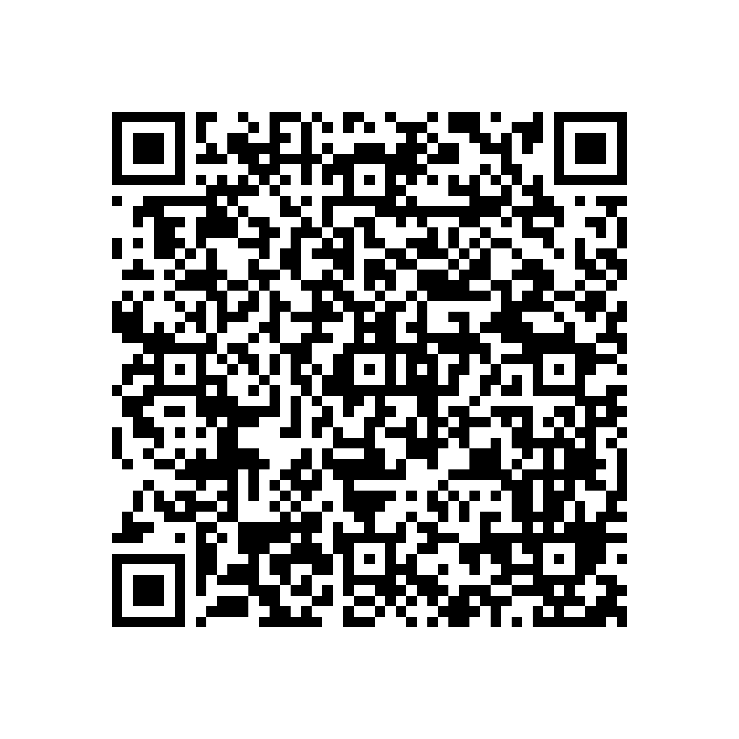

BEFORE WE START
Please fill in the Equality and Diversity Monitoring Form 2026/27

Slide 4
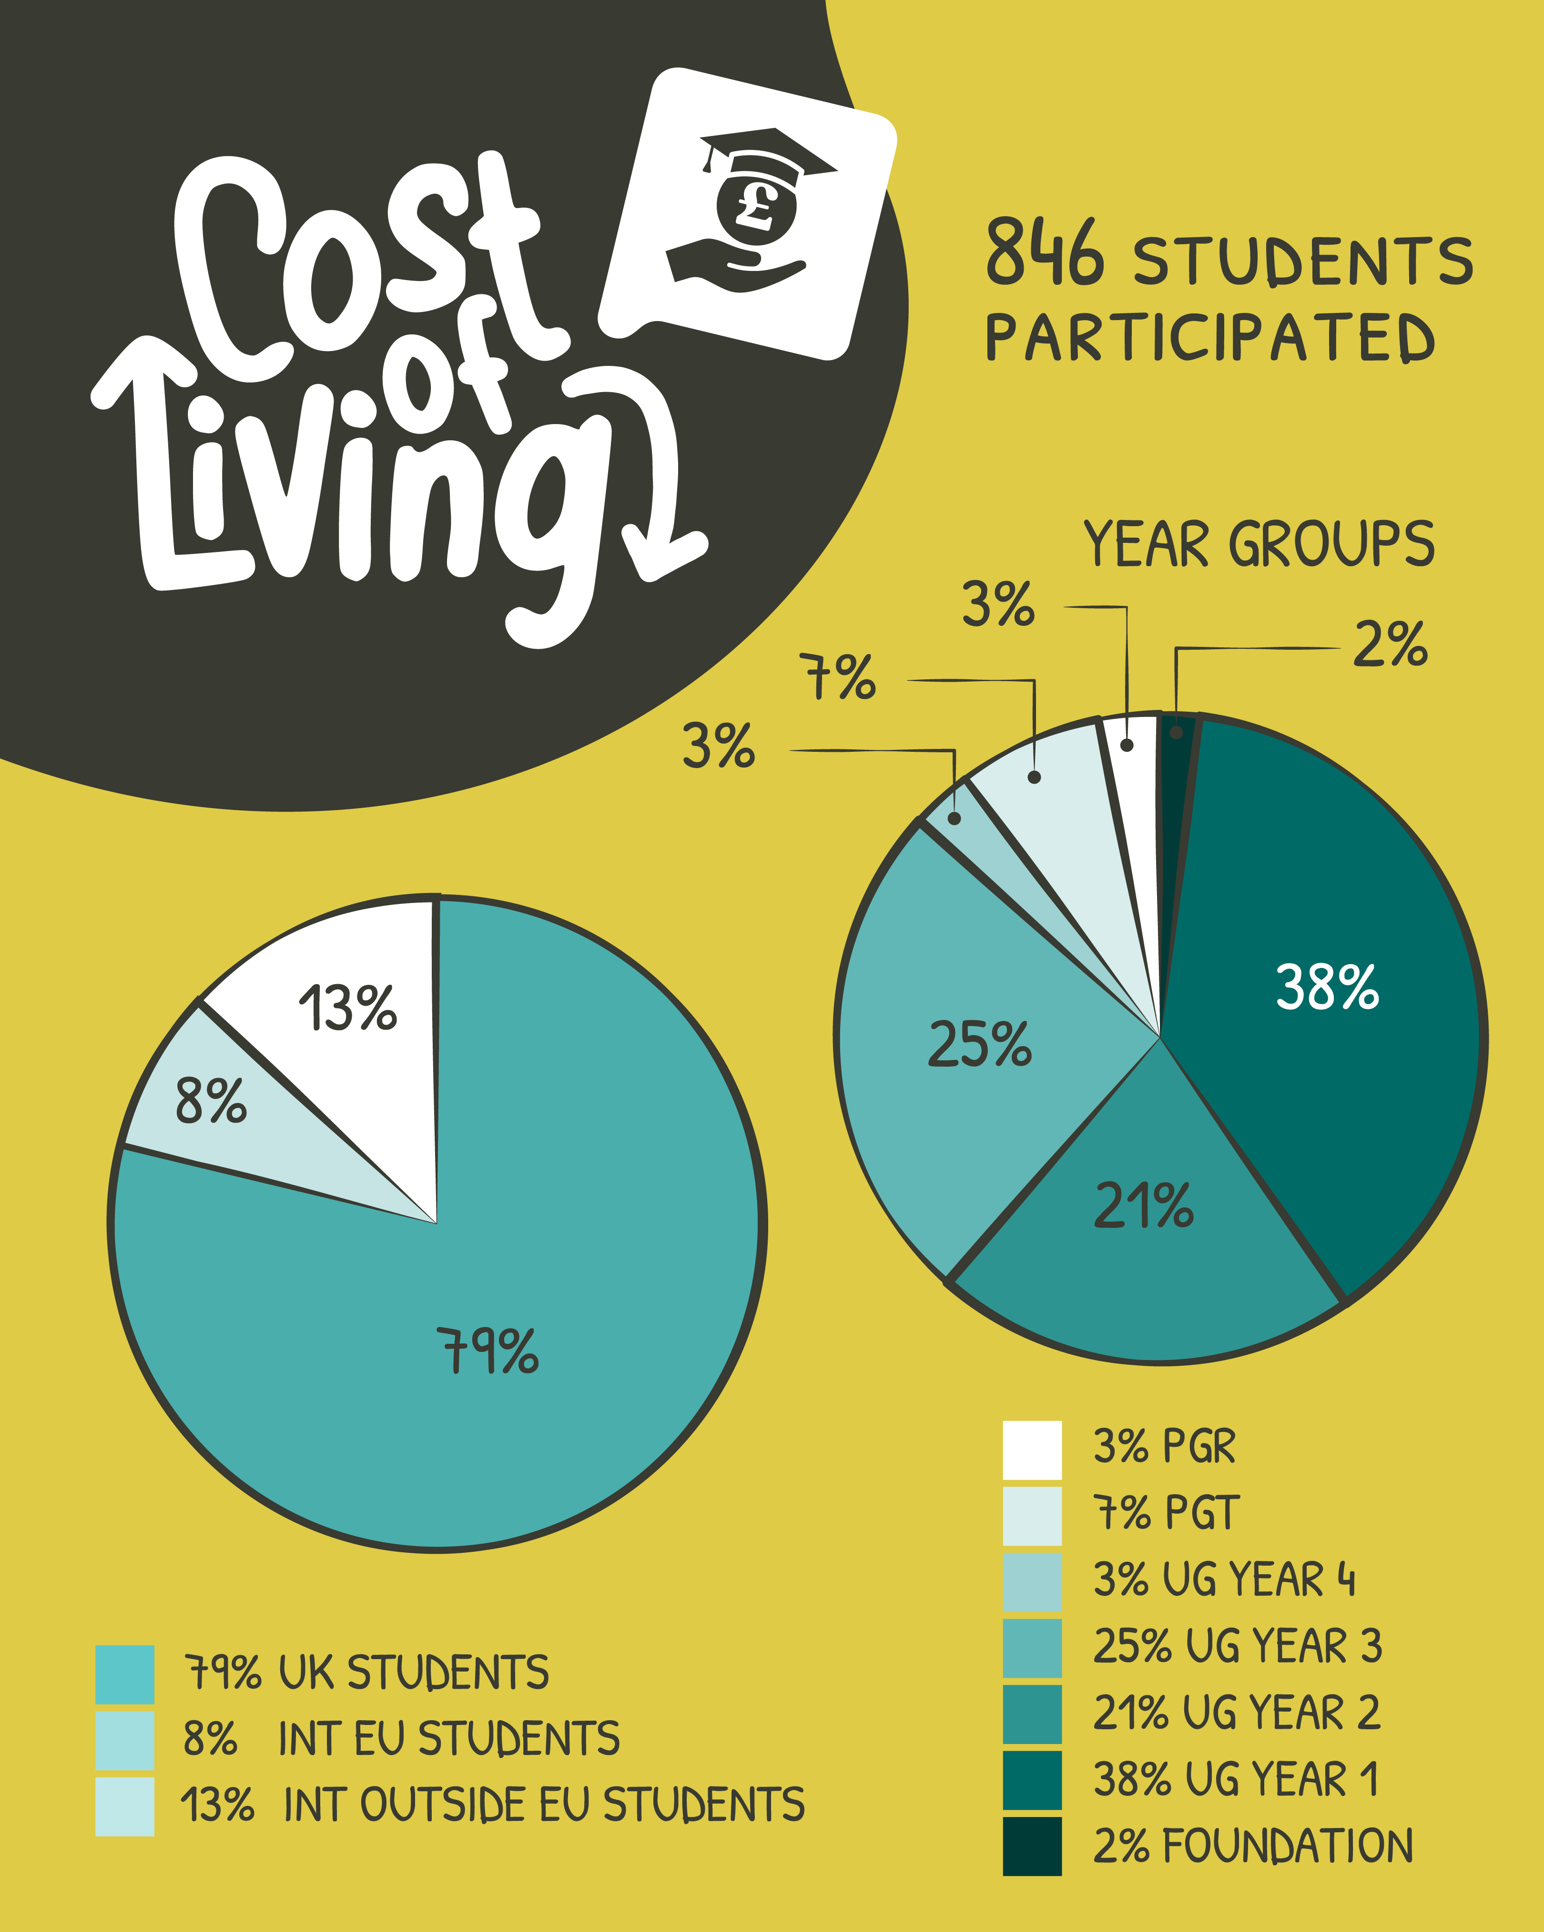
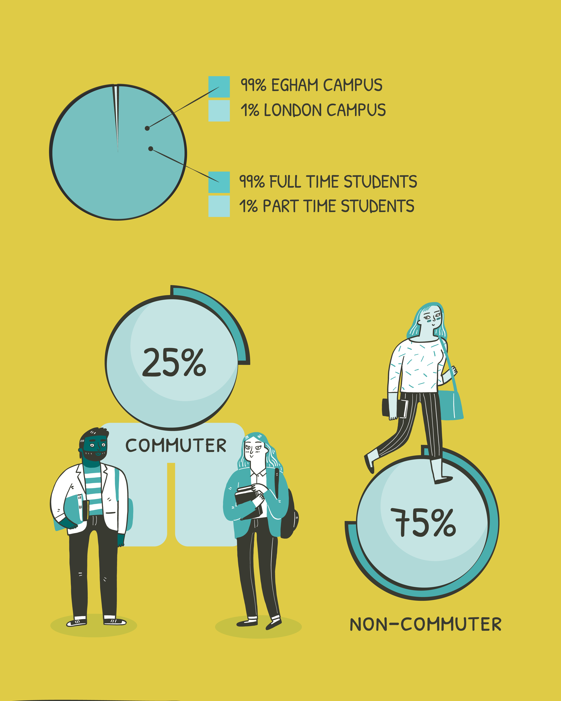


Slide 5
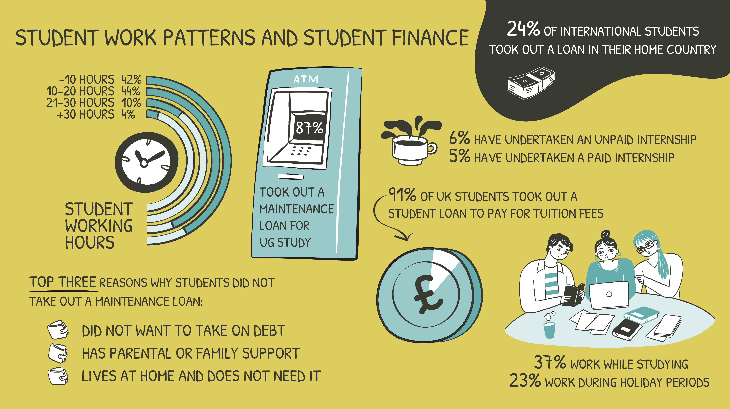

Slide 6

Further Insight: Funding / Finances
Commuters were less likely to take out maintenance loans than non-commuters
International students who did take out loans primarily relied on government or formal education loans. Small umber used private / bank loans
Most commuters live with family
Weekly transport spending commonly fell between £20-50 a week, although 20% said they spend more than £50 a week to travel
45% of campus students live in Halls, 23% live in Englefield Green, 20% Egham and 8% live in Private Halls

Slide 7
Further insight on work / internship patterns
Year Group Work Patterns
Foundation: 29% work during term time and 24% only work during holidays
UG 1: 26% work during term time, 24% work only during holidays
UG 2-4: 43-46% work during term time, 25% work only during holidays
PGT: 37% work during term time, 10% work only during holidays
PGR: 57% work during term time
Commuters were more likely to work during term time than non-commuters
Internship Experience | % of respondents (55 responses)
General unpaid internship comment | 41.82
General paid internship comment | 36.36
Internship during holidays | 21.82
Summer Skills two-week placement | 20
Gained experience | 5.45
Placement year / year in industry | 3.64
Had internship and job at same time | 3.64
Wanted to gain experience | 3.64

Slide 8
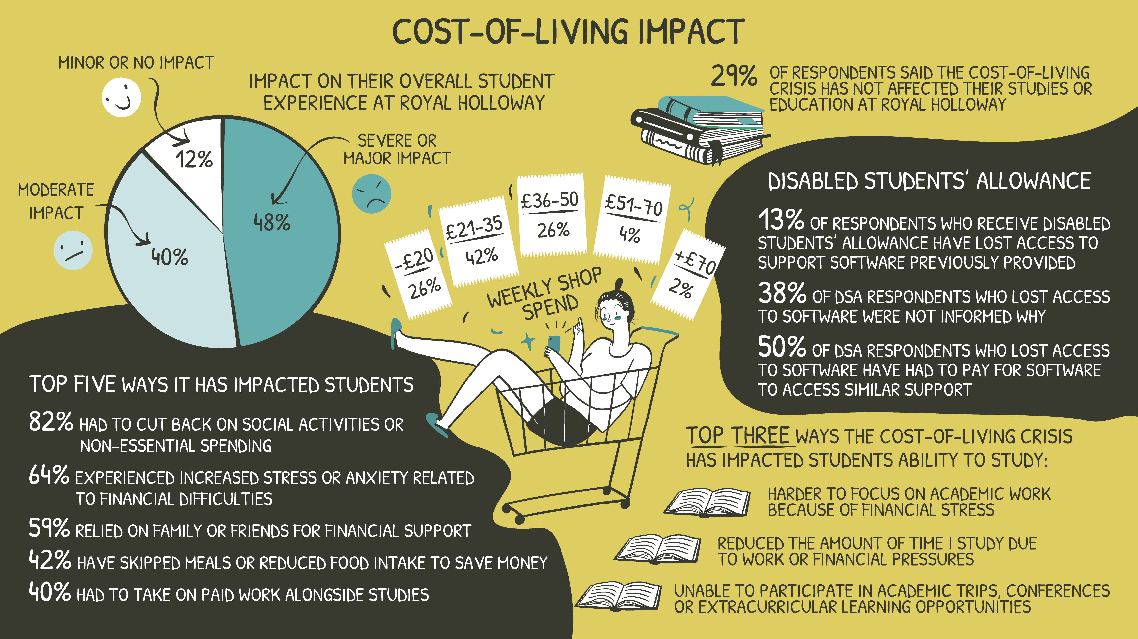

Slide 9
Other ways COL has
impacted RHUL students
In what ways has the cost-of-living crisis impacted you during your studies? (please select all that apply)
Answer | % of respondents (811 responses)
I have struggled to afford basic living costs (e.g. rent, utilities, food) | 39
I have had to reduce my study time due to work or financial pressure | 24
I have sought financial support (e.g. study support grant) | 14
I have considered leaving or pausing my studies | 11
I have struggled to afford transport to campus | 11
I have had to move accommodation due to affordability issues | 6
Other (please specify) | 2

Slide 10
Segmented Cost-of-Living Impact Data
UG Year 2, 3 and PGTs have more than 50% of responses for severe or major impact.
Campus students report a slightly higher impact over commuters
Financial strain is an issue for all ethnic groups in the survey, but Black students (including African, Caribbean, Black or Black British) were more likely to report Major or Severe Impact.

Slide 11
COL and Engagement
40% respondents reported that they are members of an SU student group or occasionally attend late-night events, and that the cost-of-living crisis has affected how much they are able to participate.
Has the cost-of-living crisis negatively impacted your ability to participate in any of the following Students’ Union events?
51% not attend late-night events
46% not visit one of our commercial outlets
41% not join a SU sports club
36% not join a SU society
10% not joint a media outlet
23% has not impacted ability to engage with the SU
UG Years 2-4 had more than 45% of respondents for each group stating it has impacted them.
International students are more affected than UK students
More than 50% of commuter students still state they do not engage with the SU
Top reasons the COL has impacted engagement:
Can’t afford nights out at the SU
Sports membership expensive
Students prioritise spending on food and rent and not entertainment / social activities
Students limit the number of SU nights they attend / in general go out less

Slide 12
Students frequently prioritised rent, food, and utilities over social engagement, impacting belonging and campus experience.
Key cost barriers:
Membership fees
Travel costs
Food and drink prices
Kit/uniform expenses
Free-text responses strongly linked financial stress to social isolation and reduced sense of community.
25% of students know about the Student Group Access Fund but have not used it
4% have used it
71% did not know about it
Foundation and UG Year One students are the least knowledgeable about the Student Group Access Fund
Barriers to Engagement

Slide 13
“Due to my long and expensive commute times, i struggle to stay within the uni and enjoy the activities like after hour clubs and any activity where i stay in Egham with friends etc.”
“Unfortunately rent and utilities are extremely expensive in this area. Therefore, I have been unable to attend and afford many events. I have had to skip meals to afford bills.”
“i joined a sports club, but i am not able to fully
immerse myself in the experience because of the
costs of travel, su nights and socials.
membership and kit fees are extremely high for
what you receive.”
Applied for the access fund to pay for [student group] membership and kit, and received sufficient funding for the membership only.
“I have JUST enough money for bills and cheap food, I have no money left over for fun. I live just on the edge of affordability with the max maintenance loan, and my parents are too poor to support me.”

Slide 14
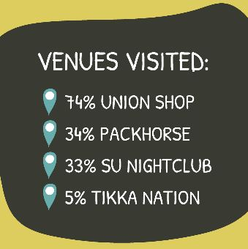
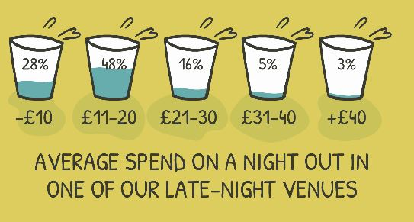
Late-night events
Rank in order of most important to least important the reason you attend a late event at one of our venues
% of respondents (391 responses)
Rank | Reason
1 | Friends are going
2 | Event theme
3 | Music
4 | Advance ticket price
5 | Drinks prices
6 | Day of the week deal (e.g. Doubledown Tuesday)
7 | Branding
UG Year One are the top visitors for the Packhorse and the SU Venue with around 40% of respondents stating they go to that venue. UG Year 2-3 are the next highest but that’s a 20% difference between year groups with only about 20% attendance for these groups.

Slide 15

Cost-of-Living and
Education
How has the cost-of-living crisis impacted your ability to study at Royal Holloway? (please tick all that apply)
Answer | % of respondents (753 responses)
I find it harder to focus on academic work because of financial stress | 47
It has not affected my studies or education at Royal Holloway | 29
I have had to reduce the amount of time I study due to work or financial pressures | 28
I have been unable to participate in academic trips, conferences or extracurricular learning opportunities | 24
I have been unable to afford course material, books or equipment | 16
I have missed classes, lectures or labs due to travel or cost reasons | 15
It has negatively impacted my grades | 13
I have delayed or changed my study plans due to financial constraints | 12
Other (please specify) | 2

Slide 16
“Mental heath decline due to financial pressures.’
“I have had to undertake paid work in an
area unrelated to my course instead of participating in voluntary activities that are related to my course.”
“Tiredness due to working two jobs, so less able to do uni work”
“I take on shifts rather than showing up to
lectures because i know if i don't, i won’t be able
to pay rent”
  “hungry more often due to lack of food sometimes so i can’t focus as well.”

Slide 17
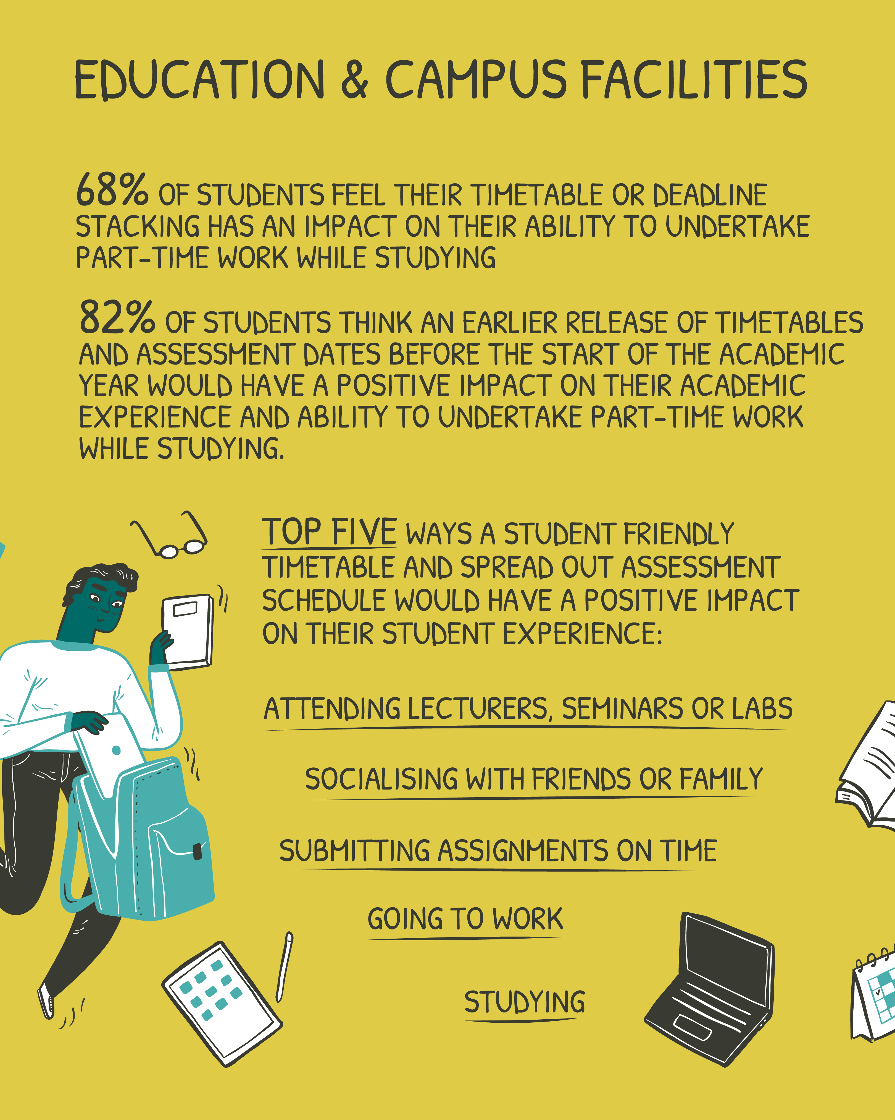
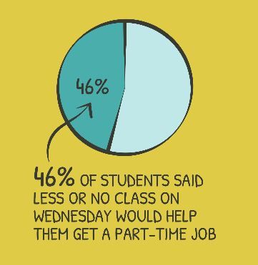
“I am unable to do most of my society training lessons due to my timetable.”
“Timetables could be released more promptly to allow for planning of home responsibilities.”
“My timetable is highly intensive within just two days: Monday and Tuesday. I work on the weekends and so I struggle to meet my deadlines and furthermore I find myself way too tired to even consider partaking in any socials. I go to uni and then come back to rest which minimises my time with my family also.”

Slide 18
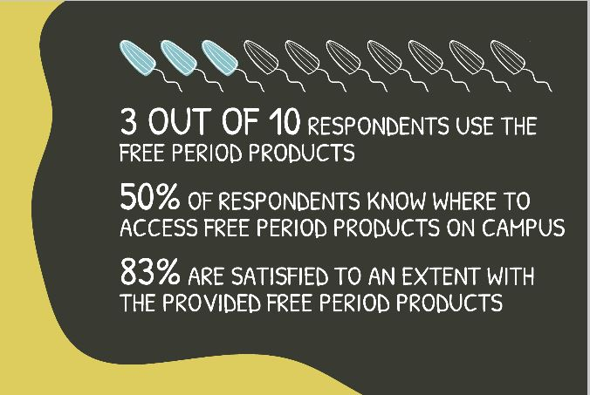
Why do you not use the free period products provided on campus? (please tick all that apply)
Answer | % of respondents (329 responses)
I prefer my own non-reusable products | 29
Other (please specify) | 29
I do not need these products | 17
The products available are unsuitable (e.g. absorbency, size, allergies) | 16
Out of stock when I need them | 15
I prefer my own reusable products | 9
Not accessible | 6
Other Response Theme | % of respondents (94 responses)
Didn’t know about them | 64
Don’t know where they are located | 17
Have own products / prefer own products | 4
Not had period while studying | 3
Run out / people take the whole box | 2
Bad quality product | 2
Forget they are available | 2
Never seen them on campus | 2
Don’t use campus toilets | 2
Other students need them more | 2
Foundation, Undergraduate Year One and PGT students had the least knowledge about where to access free period products.

Slide 19
Period Product Satisfaction
“They're good when they are there, but sometimes there are no products which can be frustrating.”
We asked students to explain their satisfaction ratings with the free period products in more detail and 77 students provided a response to the free-text box. The table below presents the common themes discussed in the comments, and a selection of student responses have been shared beneath.
“Would be good to also have large size pads for heavier flow.”
Theme | % of respondents (77 responses)
General satisfaction with products | 32.47
Products are not always available / well-stocked | 25.97
Products are available / well-stocked | 24.67
Would like more variety (e.g. for heavier flow) | 14.28
Tampons are available but not pads | 10.39
Like the product brand | 6.49
Brand is good quality | 6.49
Wants better advertising / signposting of locations | 3.90
Likes that brand is sustainable | 3.90
“It’s very helpful to have free period products, especially when money is tight.”
“There could be clearer signposting and refilled more regularly in the library spaces.”
STUDENT LEADER CONFERENCE

Slide 20
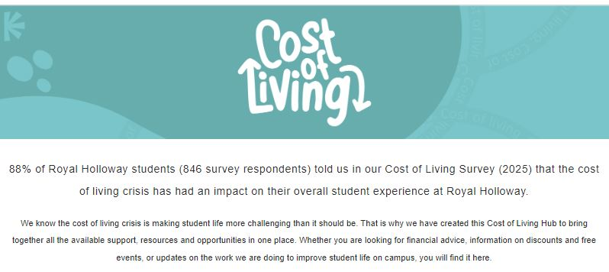
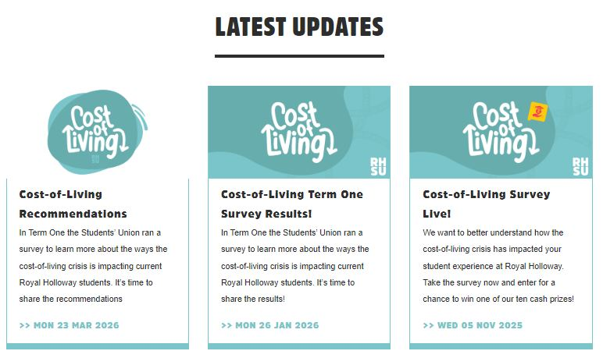
SU Cost of Living Hub

Slide 21
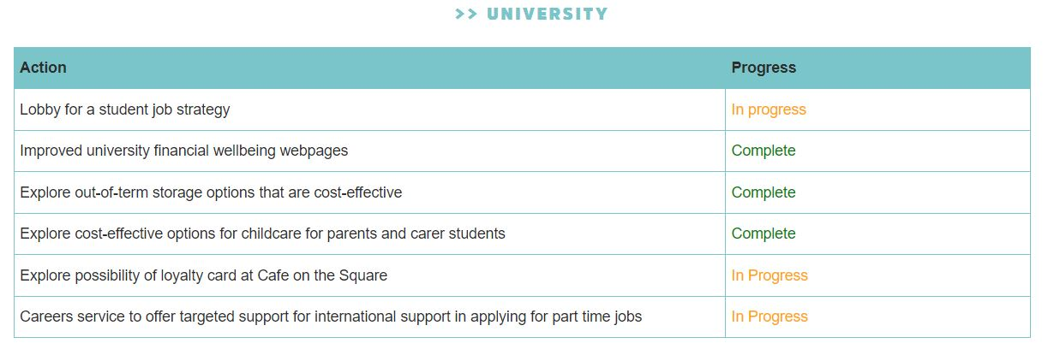
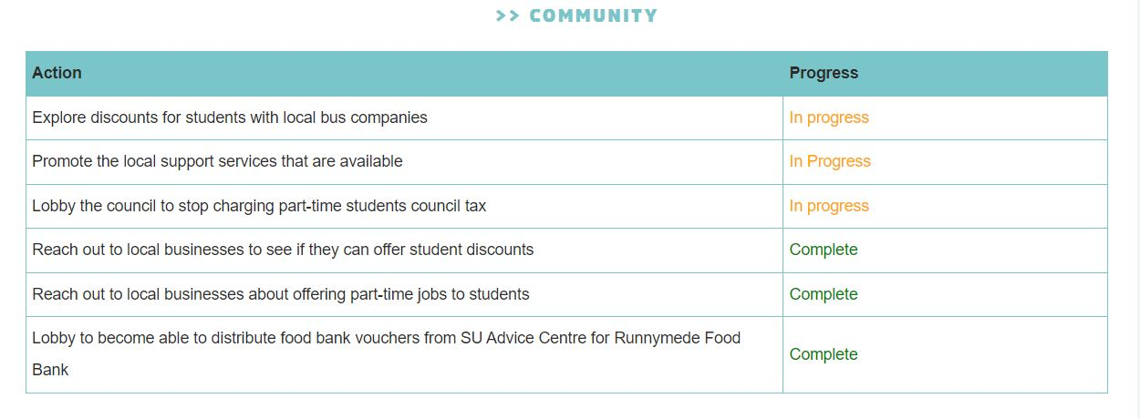
Cost-of-Living Recommendation Tracker

Slide 22
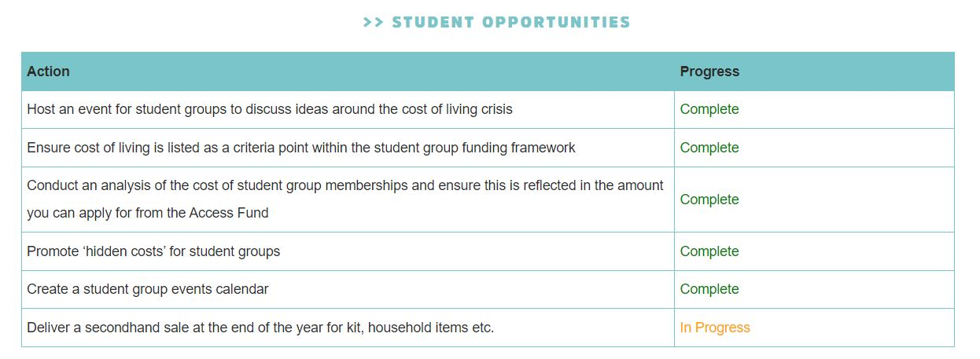
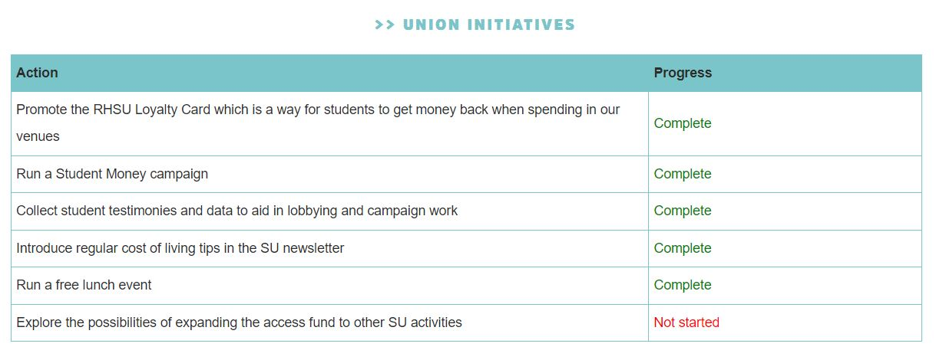

Slide 23
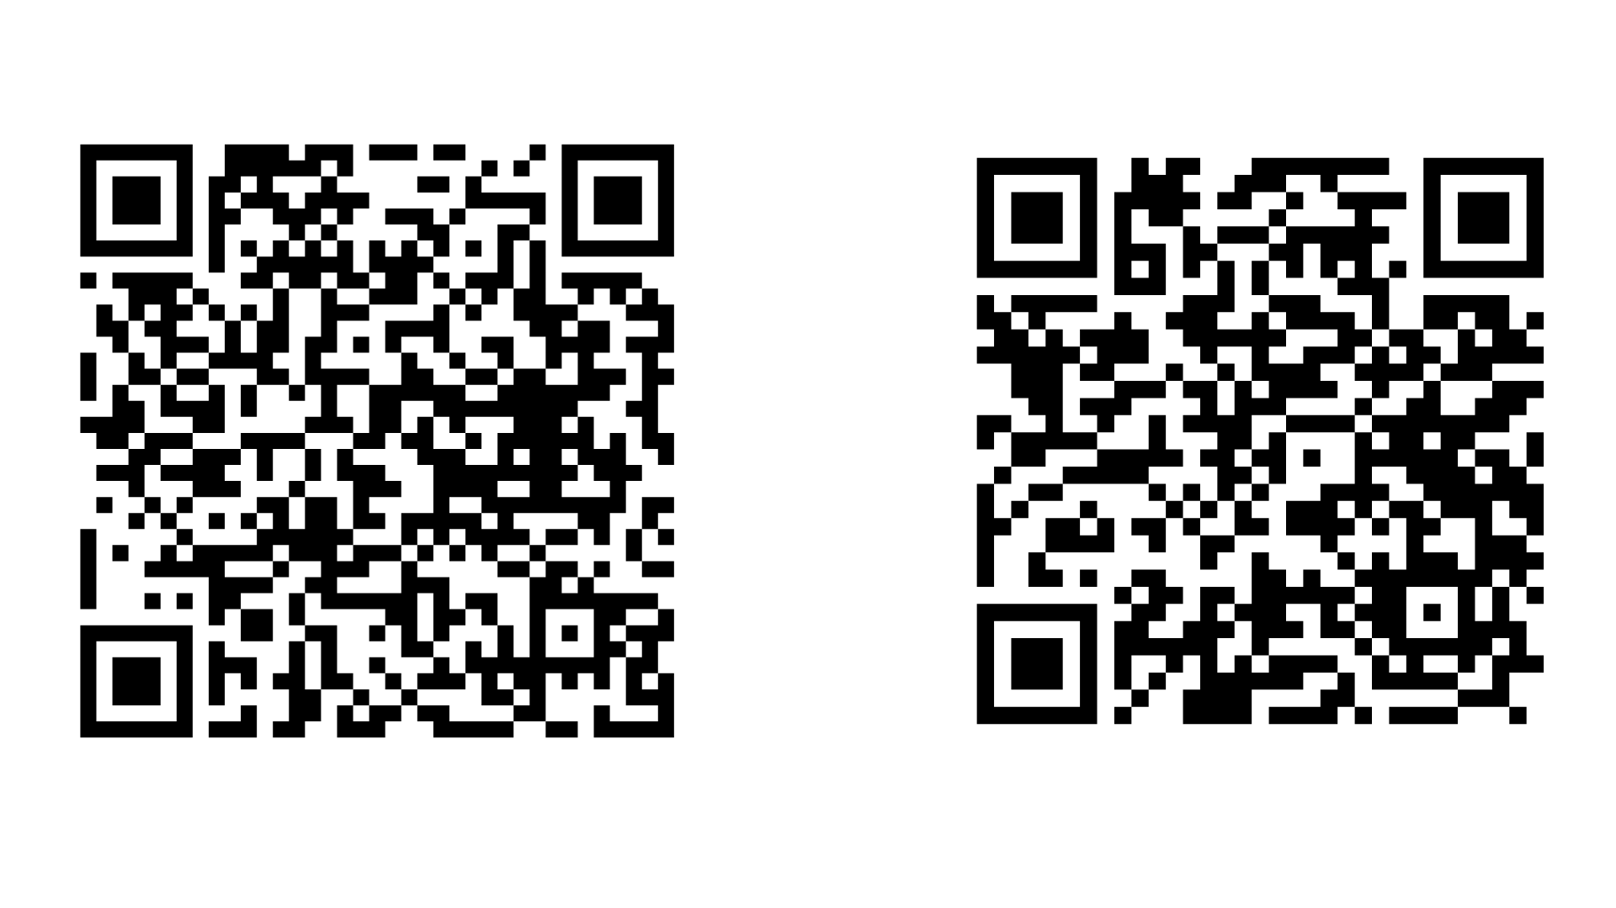
Further Information
RHSU Cost-of-Living Hub!
Full list of 2026 Cost-of-Living recommendations!

Slide 24
THANK YOU
Questions?
STUDENT LEADER CONFERENCE

