Slide 1



Slide 2
Rate Your Union Results
Student Leaders

Slide 3
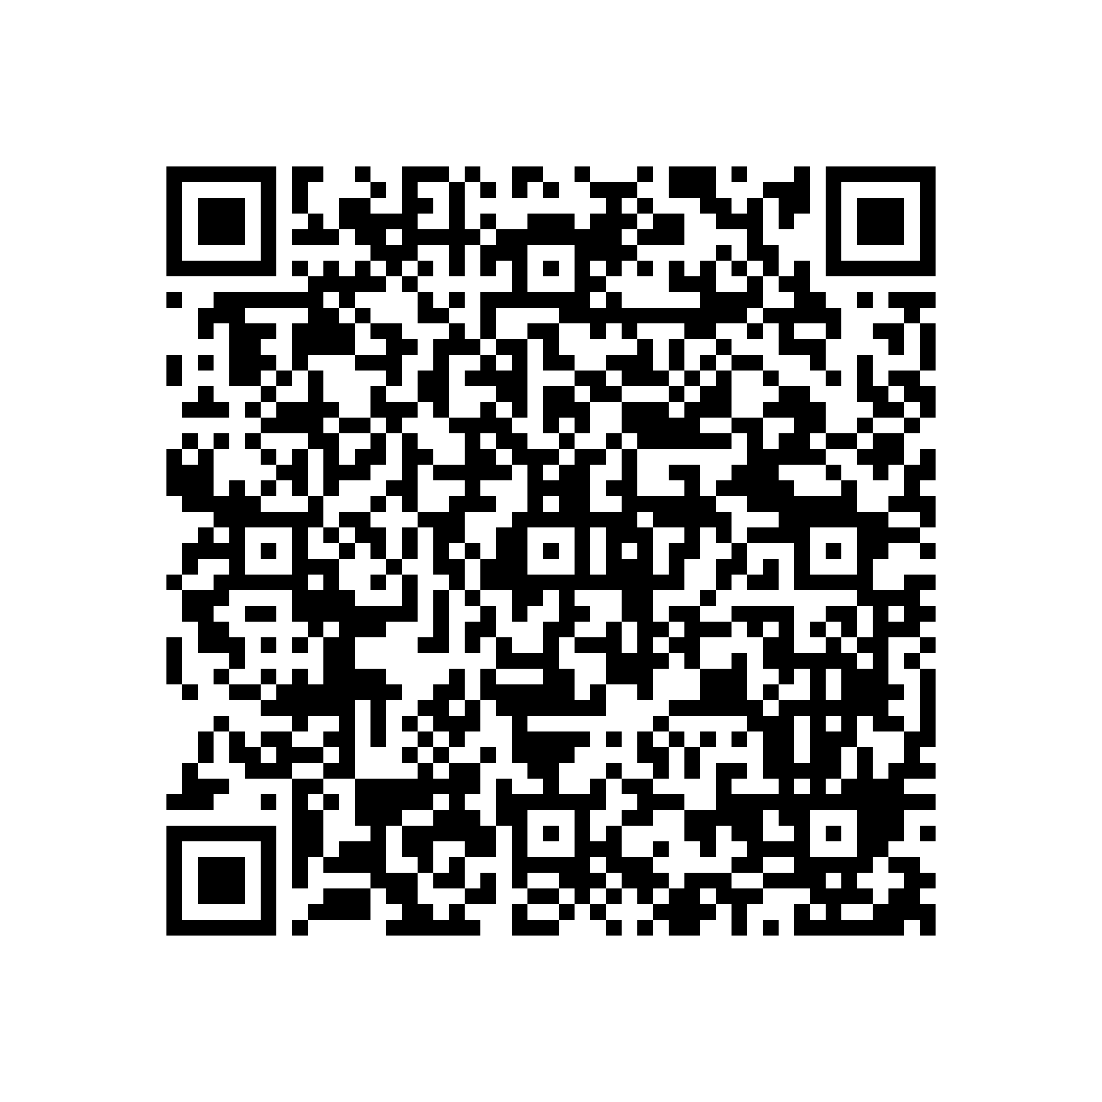

BEFORE WE START
Please fill in the Equality and Diversity Monitoring Form for 2026/27

Slide 4

Our Mission

Slide 5

Rate Your Union 2026
Our largest service provision survey. Each May we run our Rate Your Union survey so that we can make decisions directly based on student feedback about their experiences engaging with Students’ Union services, activities and events.
1058 student responses
  81% UK students
  7% International EU students
  12% International Outside EU students
All year groups represented
  Largest proportion were UG Years 1-3
99% Egham Campus
19% were commuter students

Slide 6
Student Group
Experience

Slide 7

Student Group | % respondents 2025 (1098 responses) | % respondents 2026 (1058 responses)
Societies (member) | 50% | 49%
Sports Club (member) | 24% | 24%
Student Media (member) | 4% | 2%
None of the above | 31% | 32%
% of members who were satisfied to an extent with the events run by their society, sports club and or student group
89% Society Members
87% Sports Club Members
75% Student Media Members
Student Group Participation

Slide 8
“Events are regular and varied to keep things interesting..”
“I enjoyed the events which I attended,
although quite a lot of events were held
quite late in the evenings, which didn't always suit me as a commuting student.”
“Societies were a very crucial part in meeting new people.”
“they've not done too much and they have
left announcing events till the very last moment so it has been difficult to get to them”

Slide 9

Committee Member Participation
Student Group | % respondents 2025 ( 1098 responses) | % respondents 2026 (1058 responses)
Societies (committee member) | 14% | 15%
Sports Club (committee member) | 6% | 5%
Student Media (committee member) | 2% | 1%
STUDENT LEADER CONFERENCE

Slide 10
“The SU has been supportive, and my society has thrived this year.”
“Individually the staff are all pleasant and
do seem like they are trying to help but as
an institution there are clear gaps in support that make running a student group very difficult.”
  “A lack of understanding between SU, Committee members and standard members creates tensions that are often unmanageable and extremely frustrating.”
“The drop-in sessions help with queries and
problems and the society awards has honoured
the achievement of every sport and societies.”

Slide 11
Representation and
Student Voice

Slide 12

Student Voice Survey Participation
86 Course Reps
19 Senior Course Reps
11 School Reps (Likely a mix of Senior Course Reps & School)
9 Community Officers
4 Education Executive Members
11 Wellbeing, Community & Diversity Members
23 Societies, Sports & Opportunities Members

Slide 13
Student Voice Leader Awareness
% of students who were satisfied to an extent with their student leaders representing student issues and interests this academic year
Course Reps: 73%
Senior Course Reps: 77%
School Reps: 73%
Community Officer: 75%
Student Executive (Education): 74%
Student Executive (ECD): 77%
Student Executive (SSO): 76%
Student Voice Leaders | % respondents who knew about these student leaders (989)
Course rep | 49%
Senior course rep | 22%
School Rep (2025-26) | 25%
Community Officer | 22%
Student Executive (ED) | 58%
Student Executive (WCD) | 50%
Student Executive (SS0) | 57%
None of the above | 23%

Slide 14
“I felt my issues and concerns were mostly taken into account and a solution was attempted to resolve them.”
“The reps seem to genuinely care about
all students wellbeing and put their all into making sure course opinions and wellbeing are accounted for.”
  “We don’t get information back about the feedback or changes they have made based on the forms we completed.”
“I am very disappointed in my department this year but
my student reps tried their best to sort out these issues
however there wasn’t much they could do.”

Slide 15

Ways students interacted or engaged with student leaders and/or campaigns
Activity | % respondents (945 responses)
Saw social media posts | 75%
Voted in an election | 46%
Participated in a survey | 46%
Through a student group (e.g. society) | 31%
Read blogs | 25%
Attended event (e.g. Black Creativity Showcase, LGBT+ Speed Dating) | 19%
I have not engaged or interacted wit ha student leader or campaign this year | 9%
Participated in another paid feedback opportunity | 9%
Participated in a focus group | 7%
Ran in an election | 6%
Ran a campaign | 5%
Proposed a campaign | 4%
Participated in a Policy Forum | 3%
Other | 2%

Slide 16
Strategy KPI
Objectives

Slide 17


Slide 18


Strategic Aims 2024-27
Building Communities for All Students
Building Stronger Student Voice and Representation
Providing Inclusive Events and Spaces
Providing Advice and Advocating for Students

Slide 19




v
Building Communities for All Students
Developing
Supporting
Empowering
Celebrating
Building Stronger Student Voice and Representation
Insight
Representation
Empowerment
Influence
Providing Inclusive Events and Spaces
Celebrating
Opportunity
Inclusive
Space
Providing Advice and Advocating for Students
Educate
Listen
Guide
Advocate
Guiding principles
Transparency – Equity, Diversity and Inclusion – Belonging and Wellbeing

Slide 20
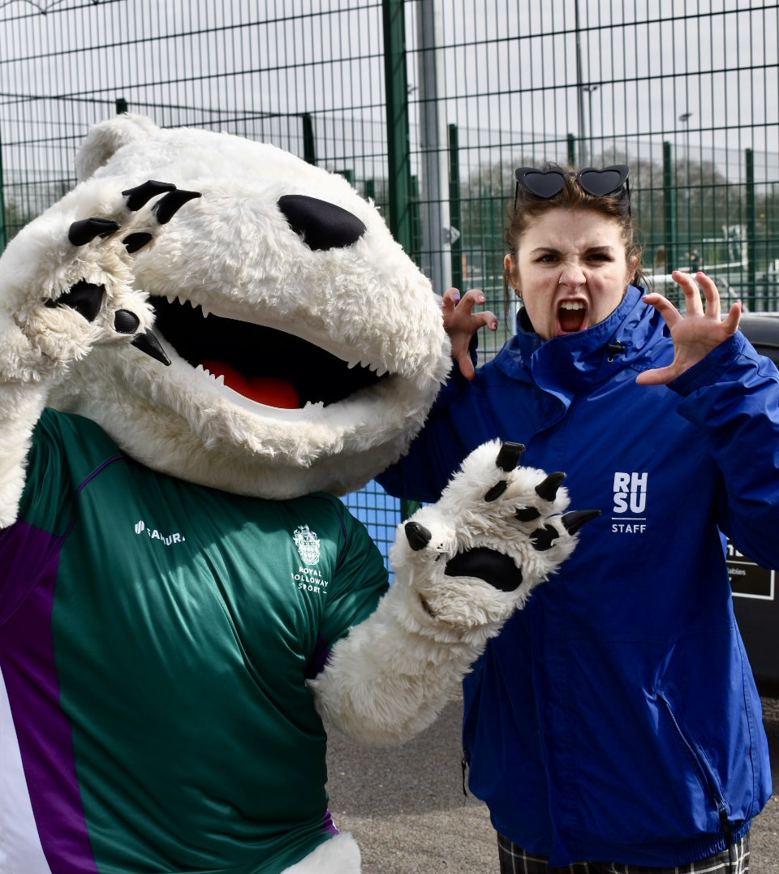
Building Communities for All Students
“Enabling student-led communities to thrive and enrich student experience through effective staff support, empowerment and celebration of inclusion, community impact and leadership.”

Slide 21

Student Group Committee Member KPI Ratings
KPI Objective | RYU 2025 | RYU 2026 | Target 2027
I feel supported in my community role and it helps the community to thrive | 87% | 85% | 80%
I feel empowered as a leader and see the success of my community | 88% | 87% | 80%
The Students’ Union supports and empowers student-led activity on campus. | 77% | 74% | 70%
The Students' Union celebrates students in their communities and values their contributions | - | 77% | 80%
Building Communities for All Students

Slide 22
“I have found in running a society this year a large lack in support from the SU when it comes to the organization and outreach of events.”
“The SU have been great support this year as we
have dealt with issues and concerns, the only downside
is the financial issues regarding invoices being sent out and payments being made to professionals which we have been hiring.”
  “the student union definitely does their part to reward societies, however, communication to societies could be a bit clearer especially when there was a change of systems this year.”
“My committee and community have been highly supportive
of my role, as has the SU eith their brilliant awards ceremony.
I do think there have been some minor issues with SU response times for room bookings and risk assessments, but little to complain about from my experience.”

Slide 23
“A lot of events proposed were viewed as great ideas from the SU. However the amount of events that didn’t happen affected my rating.”
“The SU does support activities ON campus, but receiving
support for external groups is far harder than those ON
campus. The SU does celebrate leading community members through the Societies Awards, Colours Ball, and Student Impact Awards, I feel that these are well ran.”
“I think some of this is impacted by both the SU and
internally within the society. I'd also say the SU definitely
wants to support students, but this isn't always provided. A
strong example of this might be expense claims that were never processed. Or, a lack of engagement with the on a macro-scale with the wider societies community in the year (other than Society Awards).”
  “More extensive summer training would help to ensure confidence in process.”

Slide 24
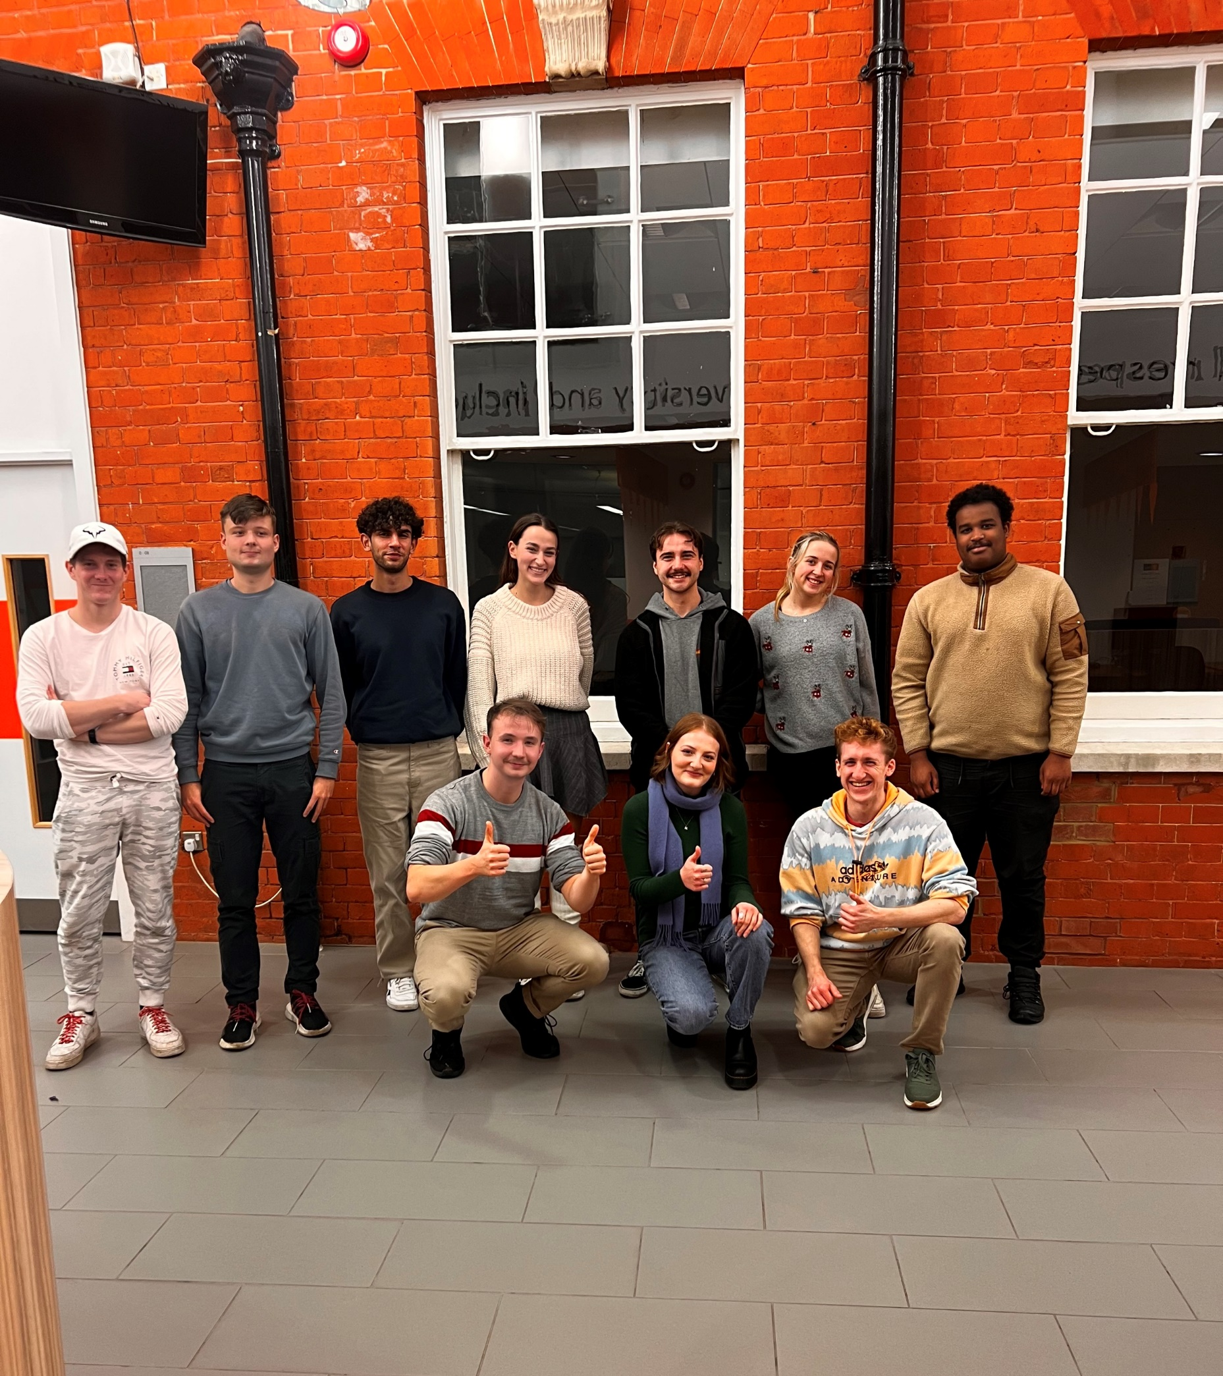
Building Stronger Student Voice and Representation
“Developing powerful student voices and representation structures to positively impact students' academic and non-academic experiences.”

Slide 25

Student Voice Leaders KPI Ratings
KPI Objective | RYU 2025 | RYU 2026 | Target 2027
The Students' Union provides me with the tools and opportunity to effect change in my community | 83% | 79% | 80%
The Students' Union celebrates students in their communities and values their contributions | - | 78% | 80%
Building Stronger Student Voice and Representation

Slide 26
“As a course rep, I struggled to find opportunities to gather information and opinions from people other than in person.”
“Being a course rep has allowed me to work closely
with my department and the staff truly care about feedback.
Also interviewing a candidate for head of department and
getting to ask questions gave me behind the scenes insight to how they make sure their staff is fit to be in their position”
“I am a rep in two departments, and have noticed a large inconsistency in the attitude of staff towards our ideas and suggestions. In one of my departments, although staff are
respectful it feels like they aren't willing to change things in response to our feedback. The other department is great and the staff really value our contributions.”
  “The process of reaching out to the SU and getting support is clear, however, the impact is not something I am farmiliar with.”

Slide 27
“The SU has persistent engagement with students and celebrates their achievements via Shout about it week, voice BBQ and more.”
“I think one of the main issues I have with the SU is
that while I’m sure they do celebrate this, I don’t know where this happens. I think there could be better advertising through the SU on campus and such.”
  “I see the representation is value but it often feels like certain groups are undermined.”
“Definitely in SSAMs seeing the impact of
student voice and departments effecting change. also with the priority 8s.”

Slide 28
KPI Ratings: All Respondents
KPI Objective | RYU 2025 | RYU 2026 | Target 2027
I feel a sense of belonging to one or more communities at Royal Holloway | 87% | 88% | 85%
The Students' Union represents me on the issues that matter to me | 73% | 75% | 90%
The Students' Union actively seeks out and engages students on their opinions | 86% interacted or engaged with student leaders and/or campaigns | 91% interacted or engaged with student leaders and/or campaigns | 90%
The Students' Union makes student life better at Royal Holloway. | 86% | 86% | 90%
I am satisfied with the Students’ Union at Royal Holloway | 84% | 82% | 90%
I know how the Students' Union works and how decisions are made. | 66% | 68% | 80%
I am kept well informed about what the Students' Union does. | 87% | 86% | 85%
Building Communities for All Students
Building Stronger Student Voice
and Representation
General KPI

Slide 29
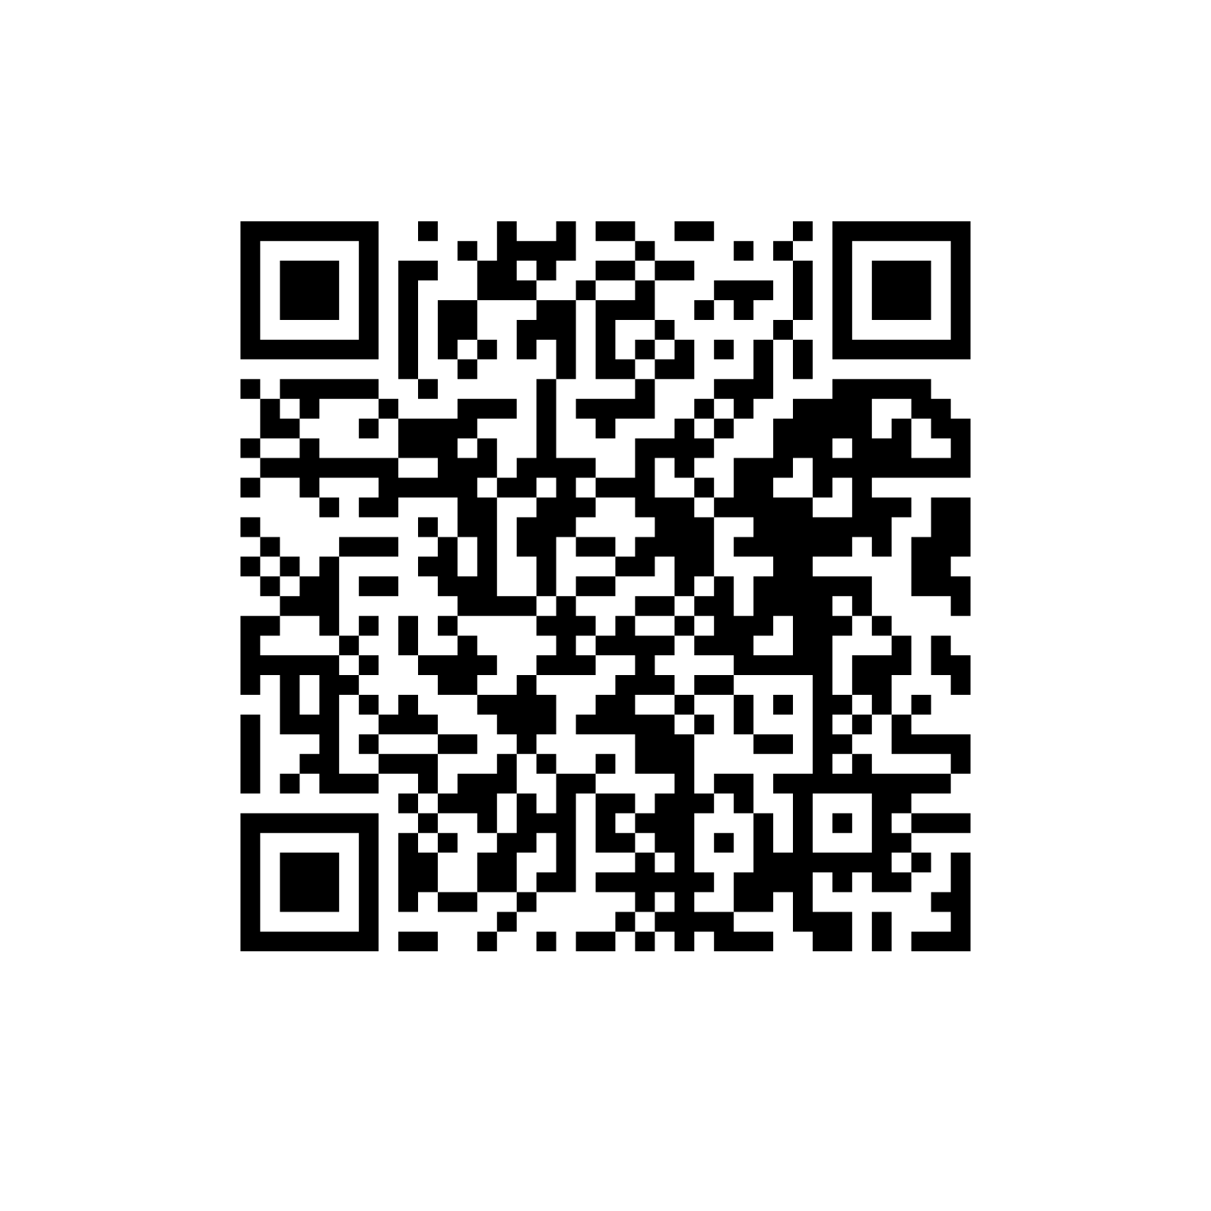
Further information
Full 2026 Rate Your Union Results will be shared on our website and social media account in Term One of the 2026-27 academic year.
Check out the 2025 Rate Your Union Results on our webpage!

Slide 30
THANK YOU
Questions?
STUDENT LEADER CONFERENCE

