Slide 1


RUNNING A CAMPAIGN

Slide 2
Welcome to Running a Campaign
Delivered by Fran Hailey, Community Engagement Coordinator, Poppy Coates Campaigns Assistant and Olivia Davies, President.
Session aims:
Running a campaign is a session developed for all Student Leaders to learn how to lead, run and successfully complete a campaign.
Campaigns can take various forms from raising awareness through a week of action with engaging events and social media content, to lobbying for meaningful change.
RHSU is here to support you throughout the process.
This session will outline the support available and provide you with training and a campaigns toolkit.
STUDENT LEADER CONFERENCE

Slide 3
1. What is a campaign
What we’ll cover today
4. Skills
If you want to run a campaign in 26/27, we’d also recommend you attend:
Meet the Teams drop In.
Accessible Social Media Workshop.
Awards & recognition.
Intro to accessibility / Fundamentals to EDI.
Understanding Your Members.
And don’t forget, do refer to the Planning Your Campaign Narrative PDF.
For further information or if you wish to chat about running your own campaign, book a meeting with Fran Hailey by contacting Voice@su.rhul.ac.uk
2. Campaign
cycle
5. How to get involved and top tips
3. Accessibility
STUDENT LEADER CONFERENCE

Slide 4

WHAT IS A CAMPAIGN
STUDENT LEADER CONFERENCE

Slide 5
What is a campaign - Lobbying campaign vs awareness campaign.
The way in which we can create change in the world and the coordination of people and resources aimed at changing a behaviour.
Campaigns can either be to lobby or raise awareness via:
  Petitions.
  Lobbying.
  Demonstrations.
  Letter writing.
  Social media.
To establish which method to take, it depends on whether the campaign’s aim is to raise awareness or lobby. Lobbying campaigns are often harder to plan as they require more strategy of delivery. Example of a Lobbying campaign is Olivia’s, Women’s Only Hours.
Campaigning only happens when actions are designed with a clear aim and are backed up by a campaign plan.
STUDENT LEADER CONFERENCE

Slide 6



Examples of successful SU campaigns
Lobbying - Women’s Gym Hours 2024-25.
History Months - Disability History Month 2026.
Awareness – Estranged Students Solidarity Week 2025.
STUDENT LEADER CONFERENCE

Slide 7
THE CAMPAIGN CYCLE
STUDENT LEADER CONFERENCE

Slide 8

What is a campaign cycle
Analysis
Evaluation
Strategy
Delivery
Planning
STUDENT LEADER CONFERENCE

Slide 9
1. Analysis
Identify the issue: What do you want to change? Why is this an issue? Do you have evidence? Who can support you?
Gathering evidence:
For some campaigns you will need to gather your own evidence and in some cases someone else will have already gathered research to back up your campaign. It just depends on the aim of the campaign and what you are trying to change.
Using someone else's research can save time, build trust with potential collaborators, allow you to find solutions for the issue, and help you deliver the campaign better. Useful sources can include the NUS (NUS Insight @ NUS Connect), NSS and any RHSU research.
However, there may not be any previous research that’s helpful for your campaign in which case you will have to collect your own data/evidence. You can collect your own data by: Running a survey, asking on Instagram, utilising community lists, talking to people, running a focus group etc.
STUDENT LEADER CONFERENCE

Slide 10
Engaging with Students
For a lot of students, there is the need to feel involved and represented by campaigns. If they do not feel that way, you might have to explain why they should care about the campaign and engage in it.
Is this issue widely felt?
If it isn't, you might need to emphasise the research behind the campaign - explaining what you're doing and why.
Is it deeply felt?
If it isn't you might need to emphasise why the students should care about it.
Is it winnable?
If it seems like a very big issue to tackle, it might be worth breaking it down into manageable chunks to have milestones to celebrate!
These questions will help shape your campaign discourse and materials, so make sure you tackle them before you get planning and designing!
STUDENT LEADER CONFERENCE

Slide 11
2. Strategy
You need to have a clear campaign aim regardless of whether the campaign aims to lobby or spread awareness. What is your campaign aim?
The lasting effect of the campaign = Impact. This is change that comes from the outcomes of your campaign Example – Change disabled student experience at Royal Holloway for the better.
Answer the question by returning to "why" are we running this campaign – problem Disabled student experience and impact Improving disabled student experience and making university services more accessible.
A clear campaign aim linked to the desired impact is ESSENTIAL.
STUDENT LEADER CONFERENCE

Slide 12
Outcomes – SMART Objectives
Identifying what outcomes would be measures for success.
Outputs = Actions taken during the campaign. Example – collected disabled student experiences & presented them to university stakeholders.
Outcomes = What happens because of those actions. Example – university stakeholders adapt services based on your feedback.
The outcomes should be contributing towards achieving the Campaign Aim.
Specific - state what is to be achieved clearly and in detail.
Measurable - how can the progress to the outcome be measured during the campaign? When do we know when it’s complete?
Achievable - is it possible to achieve within the timeframe of the campaign? What barriers are there? How do they affect the campaign to be successful?
Realistic - Do you have the resources to achieve the outcome? (time, money, skills, people…)
Time-bound - set deadlines to keep your campaign on track and keep momentum.
STUDENT LEADER CONFERENCE

Slide 13
Outcomes – SMART Objectives
Example
Improve disabled students' experience on the Egham campus by highlighting the accessible routes around campus via Instagram stories, so 50% of the disabled students' community know the most accessible ways to navigate the university by January 2027.
Specific - state what is to be achieved clearly and in detail.
Measurable - how can the progress to the outcome be measured during the campaign? When do we know when it’s complete?
Achievable - is it possible to achieve within the timeframe of the campaign? What barriers are there? How do they affect the campaign to be successful?
Realistic - Do you have the resources to achieve the outcome? (time, money, skills, people…)
Time-bound - set deadlines to keep your campaign on track and keep momentum.
STUDENT LEADER CONFERENCE

Slide 14
Time scales and management
You will want to start planning your campaign and writing your campaign proposal at least 2 month in advance.
The actual campaign proposal will need to be submitted at least 1 month in advance.
The SU has busy periods through the Academic year where more notice will be needed. (2 month's notice.)
Busy periods:
  Late August & Early September – Welcome Week.
  Term 2 – Varsity, Colours Ball & Society Awards.
  Late May – Summer Ball.
I would recommend using the SMART objectives from the previous slide to plan out all your aims for the year and when you want to accomplish them.
STUDENT LEADER CONFERENCE

Slide 15
Influence and Power
Who do you need to speak to in order to achieve your objectives?
  The SU can help signpost you to the most appropriate individuals (especially if these are university staff).
Campaigns are ultimately aimed at getting an organisation and/or individuals to agree with your position on an issue.
Groups who can affect the decision-making process:
  Decision-makers = they have the ultimate power to say yes/no.
  Influencers = they can help shape the decision-makers’ opinion.
  Allies = they will benefit from your campaign aim being achieved.
STUDENT LEADER CONFERENCE

Slide 16
3. Planning
Every objective needs to be turned into a series of actions.
Choose the actions depending on what resources you have at your disposal as well as on the nature of the objective and required outcome itself.
Possible actions can range a lot, some methods to consider:
  Lobby - meeting with decision makers and influencers to convince them to support your campaign aim.
  Raise awareness - converting people to your cause through events, stalls and talking to people.
  Gather support - show your campaign is widely supported through a petition or vote in the SU.
  Protest - hold a march or a rally to show a visible presence to your campaign and engage your supporters.
Think about the logical order of those actions!
STUDENT LEADER CONFERENCE

Slide 17
Campaign and awareness week examples:
Wobble Week.
Campus Unity Week.
Trans Awareness Week.
Anti Artificial.
Safe Travels.
*All Community Officers are expected to lead at least one campaign (excluding History Months). This can be a campaign led by the SU (see above) or one you lead as a Community Officer.
STUDENT LEADER CONFERENCE

Slide 18
Liberation History Months
Black History Month (October).
Disability History Month (November).
LGBT+ History Month (February).
Women’s History Month (March).
Fran will kick off planning for History Months with the Community Officers*. But our goal for 26/27 is to have as many Students and Student Communities as possible involved in History Months and we are always open to celebrating more if ideas are brought to the SU!
*Community Officers are expected to lead on History Months according to individual job descriptions and alongside Fran, reach out to Student Communities to ask for their involvement.
STUDENT LEADER CONFERENCE

Slide 19
4. Delivery and Monitoring
Build a campaign team: As the campaign grows more people will be aware of it and the potential of the campaign increases, but it’s always useful to have a strong core team from the start.
Identify the groups or people who might be interested and think about:
  How you can get them involved.
  What they can do to help.
  What they would get out of it.
  How you're going to recruit them.
Engage meaningfully.
  Make clear what you're hoping to achieve.
  Find out what their motivations are as well.
  Involve other members of the team in the decision-making process and always keep people up to date.
  Show campaigners the impact they are having - thank them!
STUDENT LEADER CONFERENCE

Slide 20
Organisation and communication
To host a campaign, event or project you must fill in a campaign proposal form which can be found on the RHSU website and send your campaign proposal to Voice@su.rhul.ac.uk . This ensures that your events are not clashing, meets the values of RHSU and we can provide the appropriate support. Fran will then get in touch to kick-off planning.
For help and more guidance on filling out the campaign proposal form, you can check out the student campaigning guide which will be uploaded alongside these slides.
The campaign plan is crucial to keep on top of its organisation.
Make sure once it is agreed upon that plan is shared with everyone in the team.
It could be useful to have someone responsible for keeping track of the plan and its deadlines.
The campaign team need to stay in touch – meet, meet, meet!
STUDENT LEADER CONFERENCE

Slide 21
Monitoring campaign progress
Making adjustments can seem difficult but it should not hold you back from putting your and your team mate’s mental health and capacity first.
  Even successful actions can have unexpected outcomes!
  Understanding why something didn’t go to plan will help your future actions.
You can make adjustments on:
  Budget – Did something end up being cheaper/more expensive than accounted for? How do you adjust the money left over to ensure everything is covered?
  Timeline – Do you need to adjust the timeline due to assignments? Did you gain a new team member that’s speeding up the rhythm of the campaign?
  Resources – Did you get access to a new archive service? Do you have a new contact that can help influence a community?
  Scope – Can you deliver all the outcomes that you set for yourself at the start of your campaign? Has there been any unexpected circumstances? Can you bring your campaign further than expected or do you have to scale back?
Setbacks are natural and you should not despair. You have got this!
STUDENT LEADER CONFERENCE

Slide 22
5. Evaluation – Evaluating the campaign
To what extent did you achieve your objectives? Have they brought about the overall campaign aim (or desired impact)?
  If any objectives were not achieved, why was that? Were the plans realistic?
Did the actions match up to what you were hoping to achieve? Was this due to mistakes in planning or external factors? How will you prevent that from happening next time?
  Make sure to analyse any faults and what you have learnt from it, this will help us find a way to support you better in future campaigns and to avoid the same mistakes from happening.
Measuring campaign success is not a very intuitive process.
  Measure what impact the changes you achieved have had in reality.
  Allow for time to see the changes unfold! Not everything will be immediate.
  Hold a focus group or online survey to consider the impact of your campaign in a few months' time - what aspects have you considered as measurable and have they upheld their measures?
Does anything still need to be achieved? Have other issues arisen? Make sure that is considered for the next campaign cycle. If applicable, Fran will schedule a meeting to discuss.
STUDENT LEADER CONFERENCE

Slide 23
Celebration and next steps
Celebrate your achievements even if you didn’t fully meet the campaign aim!
  This makes people aware of what has happened.
  It helps market your campaign as successful – can help recruiting future members and maintaining momentum.
  Makes people feel valued.
  Take care to thank everyone that took part.
Campaigning is a cycle – sometimes the obvious next steps can be to campaign on the unfinished issues.
  You can take what you learned from the previous campaign into building the next one.
Fill up a reflective log to ensure everything is written down and share it with the SU so we can improve our support! You can find a reflection template document which will be uploaded alongside these slides.
Recognise and award.
STUDENT LEADER CONFERENCE

Slide 24
ACCESSIBILITY
STUDENT LEADER CONFERENCE

Slide 25
Accessibility
It's important to talk to people in advance about their accessibility needs. That person knows what their needs are better than anyone else, so it is always best to talk to them directly and as early as possible.
Everyone faces different barriers e.g.
Physical access needs.
Mental health issues.
Learning disability.
Language or communication barriers.
Financial difficulty.
Religious or cultural practices.
Perceived (or real) prejudice or stigma.
Make sure you ask at the beginning of a session/when the posters/social media posts go out if anyone has any access needs and to get in contact with a member of the society if they do so that you can work together to figure out what needs to happen.
STUDENT LEADER CONFERENCE

Slide 26
Things you can do to improve accessibility
Things you can do to improve accessibility:
Make sure any videos that you share are captioned.
Use image descriptions.
Think about the colours and fonts you use.
For longer events think about implementing short breaks into your activity so people can have a rest, use the toilet etc. and make sure you let people know about the breaks at the beginning/before the event.
When booking a room for an activity, make sure it is fully accessible to your members - Are there stairs? Is it noisy? Are there toilets close by?
Try to make some activities alcohol free as some people may not be able/want to drink but still want to be included and have fun!
Consider whether in-person events could also be joined virtually for those with mobility issues etc.
Be mindful of your content and include trigger warnings/content warnings (tw/cw) if there is discussion of triggering or sensitive topics.
Think about having alternative payment methods - e.g., for more expensive events, consider a payment plan so people can pay for the activity over a longer period in more manageable increment.
STUDENT LEADER CONFERENCE

Slide 27
Accessibility by design at events
Key principle of accessibility to ensure your events are accessible for all students:
Inclusive planning from the start:
Engage with individuals with disabilities or additional requirements during the planning process.
Chat to the Voice Team who can help.
Check about dietary requirements, consent to photos, quiet spaces available for sensory sensitivity and feedback mechanisms (available in some lecture theatres) are encouraged when applicable.
Physical accessibility
Ensure venues are accessible and provide clear signage and adequate lighting / sound.
To be included in risk assessments.
Communication accessibility
Provide materials in multiple formats and write sentences clearly in short forms.
Offer live captioning, sign language, interpreters, or real-time transcription.
Emergency Procedures
Alongside someone in the Voice Team, if applicable make or remind yourselves of emergency evacuation plans and ensure it is inclusive for all attendees.
STUDENT LEADER CONFERENCE

Slide 28
Accessibility by design on socials
Writing Alt Text and Image Descriptions
If someone went on your website, social media or profile with their eyes closed, would they still be able to find their way around? By adding alt text and image descriptions, barriers are lifted, and more people can access your content.
There are loads of different ways you can describe images on social media, and it can all be a bit confusing.
So, what is the difference between alt text, image descriptions and captions?
Alt Text
Stands for Alternative Text, acts as an alternative to an image/file for people who use screen readers.
A brief explanation of an image.
Included within the coding on the digital image/file.
It’s not permanently visible, but it is built into sites like Instagram which produce their own alt texts for images that you can edit and add to which are then read by screen readers.
STUDENT LEADER CONFERENCE

Slide 29
Accessibility by design on socials
Image description
Detailed explanation of an image that provides textual access to visual content.
Should also be included in the alt text so that all the information is accessible.
They put all the visual aspects of an image in writing so disabled users can access it in other ways via things like screen readers.
IDs can help identify all parts of an image or details that a disabled person may have missed from just the image/caption itself.
Caption
A brief explanation that provides further information about an image.
They don’t need to focus on the visual components or descriptions.
Doesn’t have anything to do with the image description and isn’t required for any accessibility needs.
You get a free range over if or what your caption is!
STUDENT LEADER CONFERENCE

Slide 30
Accessibility by design on socials
Colour People with limited vision need content to have enough contrast to read it. This means that the background colour and the colour of the text need to be clear and contrasting for it to be accessible for everyone.
When to use:
Colour contrast requirements only apply to text and graphics that are essential for understanding the content or functionality.
You don’t need to meet any colour contrast requirements for logos or incidental graphic elements - e.g. an emoji.
Text that is part of a logo does not need to meet contrast requirements either.
Tips:
Try not to use pure black text on a pure white background. Try to temper the colours slightly. Pure black on white gives a stark contrast which can cause text to be blurred or move about for some people.
If you want to put text over an image, simply add a solid background behind the text to a dark overlay to the image to make it more accessible.
Don’t use colour alone to convey meaning - use icons, written content, and other visual elements to reinforce clear communication of content - e.g. someone may be red-green colour-blind so can't reliably make sense of information conveyed with colour alone.
STUDENT LEADER CONFERENCE

Slide 31
Accessibility by design on socials
Font
Things to consider:
Use a large enough font size in the body of your text so that people can comfortably read it - size 16 is suggested.
Try to use sans-serif fonts as these lack the decorative feet (serifs) that can appear blurry on some screens.
Your chosen text performs well when it's big or small.
Individual letterforms are distinct in shape, making sure that they can't be confused with other letters and are clear/easy to read.
Make sure the line height, width and type size are all consistent and clear - lines that are too close together or massively spaced apart can decrease readability by making it harder for the eye to know where to return to when the line breaks.
When using headers, try and make sure they are slightly different from the rest of the text by putting them in bold for example.
Try and make sure that key information is discernible immediately.
Design posters/social media posts minimally and intentionally so that the reader can get as much info as quickly as possible. Also, consider your required reading order to make sure your information flows and is easy to understand.
STUDENT LEADER CONFERENCE

Slide 32
Other tips on a digital accessibility
On Word there is an amazing feature that lets you check the accessibility of your document!
To use this, go onto a file, click inspect document, then click check accessibility, and it should tell you all the things that need to be changed to make it as accessible as possible!
Additionally, a Social Media Accessibility session is being held 15:10-15:40 in Bourne Lecture Theatre 2, and tomorrow 10:00-10:50 an Introduction to Accessibility sessions is being held in Moore Auditorium. Want to know more? Go check them out!
Is there anything you have experienced or done to improve accessibility at events?
STUDENT LEADER CONFERENCE

Slide 33
SKILLS
STUDENT LEADER CONFERENCE

Slide 34
What skills will you develop when you lead a campaign:
Diversity & Inclusion.
Student Engagement.
Event Management.
Crisis Management.
Campaign Management.
Collaborating with student groups & staff (Stakeholder Management).
Community Outreach.
Project Management.
Signposting & Promotion of relevant schemes.
Student Representation.
STUDENT LEADER CONFERENCE

Slide 35
HOW TO GET INVOLVED AND TOP TIPS+
STUDENT LEADER CONFERENCE

Slide 36
If you’re a student or student group, how do you get involved?
Leading a campaign is open (and encouraged) to all Students and Student Communities and the SU is here to support campaigns including funding, promotion and additional support.
The Campaigns Hub on the RHSU website has everything you need to know about running a successful campaign, how to get started and the Campaign Proposal form.
The proposal will ask what type of campaign, budget, campaign aims and other questions like how does the campaign meet the values of RHSU.
Fran then reviews the campaign proposal and contacts the campaign lead to organise a meeting to kick off the campaign!
Or contact Voice@su.rhul.ac.uk if you already have an idea and let’s get started!
*Community Officers are also expected to use the form for campaigns outside of their expected activity or can utilise 121’s to submit a campaign proposal. Fran will be in contact if a Community Officer is expected to be involved a particular campaign like a History Month.
STUDENT LEADER CONFERENCE

Slide 37
Staff Support
RHSU Staff are here to support you on your campaign journey.
Fran is responsible for admin including space bookings, creating campaign pages and the overall coordination of campaigns (big win for you) but you lead and decide everything else!!
Fran is supported by a Campaigns Assistant who will create risk assessments, add events to the website and complete any ad hoc admin.
Fran Hailey – Francesca.haileyu@su.rhul.ac.uk
VP Wellbeing & Diversity – VPWellbeingDiversity@su.rhul.ac.uk
Student Voice – Voice@su.rhul.ac.uk
Community Officers will receive support in their 121’s with Fran and can always email Fran or the Voice Team for additional meetings or support.
STUDENT LEADER CONFERENCE

Slide 38
Our top tips for campaigning from our Campaign's Assistant, Poppy
Take time to plan – think short and long term.
Think about your campaign team.
Use different methods to engage your community.
Be unique with your events – the RHSU values include Brave after all!
Consider accessibility.
Schedule your time.
Utilise the support from the SU.
Celebrate small wins.
Collaborate with other student communities – Community Officers, School Reps or Student Groups.
Remember to take breaks and put yourself and your needs first.
STUDENT LEADER CONFERENCE

Slide 39
QUESTIONS?
STUDENT LEADER CONFERENCE

Slide 40
THANK YOU
STUDENT LEADER CONFERENCE

Slide 41
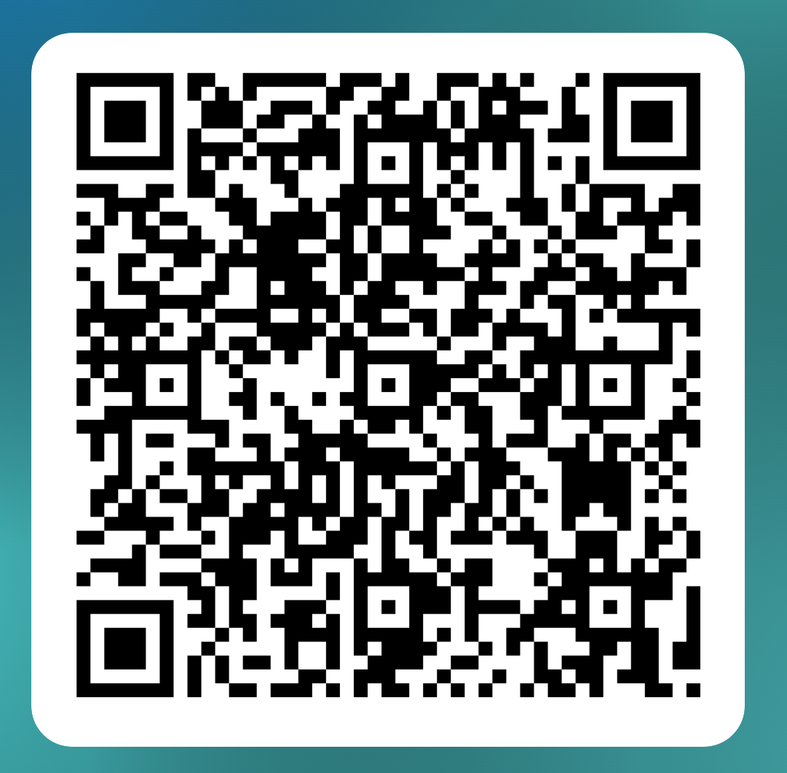
Equality and Diversity Monitoring Form 2026/27
STUDENT LEADER CONFERENCE

