Slide 1


Understanding Your Members

Slide 2
Student insight on campus life and what students want from communities.
This section will look at student insight about student demographics, campus life, busy days on campus and interest in student groups!
STUDENT LEADER CONFERENCE

Slide 3

Campus Demographics
Residence:
23% in Halls.
77% Not in Halls.
Fee status:
84% Home.
16% International.
Ethnicity:
47% White.
32% Asian.
8% Black.
7% Mixed.
5% Other.
1% Unknown.
Commute Distance:
58% <30 mins.
20% 30 mins to 1 hour.
20% >1 Hour.
Study Level:
85% UG.
9% PGT.
6% PGR.
STUDENT LEADER CONFERENCE

Slide 4
Religion | % of students
No religion | 37%
Christian | 23%
Muslim | 19%
Information refused | 7%
Hindu | 6%
Sikh | 4%
Spiritual | 2%
Buddhist | 1%
Any other religion / belief | 1%
Not known | 1%
Jewish | <1%
STUDENT LEADER CONFERENCE

Slide 5
Commuter Growth
Royal Holloway’s commuter cohort has increased year on year.
Between 2017/18 and 2023/24 numbers grew from 27% to 40% of the total cohort (all levels of study).
This represents an extra 2,178 commuter students on campus compared to 2017/18 (2,831 increasing to 5,009).

Slide 6
Campus Patterns
The University Data Management Team have found that Monday, Tuesday and Thursday are the busiest days of the week in terms of student attendance to teaching sessions. These are days to consider when planning events and socials on campus.
There has been an increase in attendance over the past three years, especially on Tuesdays.
Tuesday is the only day with a different pattern to start and end times for teaching sessions. All the other days of the week have the same pattern.
Some Departments finish teaching early on Wednesday, which allows for sports participation. But this is not across all Departments.
Importantly, this data is based on in-person sessions and reliant on students’ self-registration of attendance.
STUDENT LEADER CONFERENCE

Slide 7
Barriers to engagement sports:
Low Engagement Among Commuters and PGRs: Commuters consistently under-engage in all areas: sport participation, membership, feeling of belonging, and awareness of support services. Only 26.76% in the survey were part of an SU sport group.
Barriers to Participation: Beyond cost and time, students cited intimidation, exclusive culture, and a lack of beginner support as key barriers. Students want more inclusive and affordable options, especially beginner-friendly sessions and women-only hours.
Diverging Experiences: Lower team dissatisfaction within SU Sports Clubs where students feel like they pay more than what they get, and they lack recognition.
Events: Students want a more centralised event/schedule where they can see all activities, socials, practices and fixtures in once place. Students also want more taster sessions and beginner activities in Term Two.
.
STUDENT LEADER CONFERENCE

Slide 8
Planning inclusive events, accessible communication and best practice
This section will detail ways you can ensure your events are inclusive, your social media is accessible and tips for best practice to support and understand your members!
STUDENT LEADER CONFERENCE

Slide 9
Inclusive events and accessible communication?
It's important to talk to people in advance about their accessibility needs. That person knows what their needs are better than anyone else, so it is always best to talk to them directly and as early as possible. ​
​
Everyone faces different barriers e.g. ​
​
Physical access needs​.
Mental health issues​.
Learning disability​.
Language or communication barriers​.
Financial difficulty​.
Religious or cultural practices​.
Perceived (or real) prejudice or stigma.​
​
Make sure you ask at the beginning of a session/when the posters/social media posts go out if anyone has any access needs and to get in contact with a member of the society if they do so that you can work together to figure out what needs to happen.
STUDENT LEADER CONFERENCE

Slide 10
Things you can do to improve accessibility ?
Things you can do to improve accessibility: ​
Make sure any videos that you share are captioned.​
Use image descriptions.​
Think about the colours and fonts you use.​
For longer events think about implementing short breaks into your activity so people can have a rest, use the toilet etc. and make sure you let people know about the breaks at the beginning/before the event.​
When booking a room for an activity, make sure it is fully accessible to your members - Are there stairs? Is it noisy? Are there toilets close by?​
Try to make some activities alcohol free as some people may not be able/want to drink but still want to be included and have fun!​
Consider whether in-person events could also be joined virtually for those with mobility issues etc.​
Be mindful of your content and include trigger warnings/content warnings (tw/cw) if there is discussion of triggering or sensitive topics.​
Think about having alternative payment methods - e.g., for more expensive events, consider a payment plan so people can pay for the activity over a longer period in more manageable increment.
STUDENT LEADER CONFERENCE

Slide 11
Accessibility by design at events?
Key principle of accessibility to ensure your events are accessible for all students:
Inclusive planning from the start:
Engage with individuals with disabilities or additional requirements during the planning process.
Chat to the Voice Team who can help.
Check about dietary requirements, consent to photos, quiet spaces available for sensory sensitivity and feedback mechanisms (available in some lecture theatres) are encouraged when applicable.
Physical accessibility
Ensure venues are accessible and provide clear signage and adequate lighting / sound.
To be included in risk assessments.
Communication accessibility
Provide materials in multiple formats and write sentences clearly in short forms.
Offer live captioning, sign language, interpreters, or real-time transcription.
Emergency Procedures
Alongside someone in the Voice Team, if applicable make or remind yourselves of emergency evacuation plans and ensure it is inclusive for all attendees.
STUDENT LEADER CONFERENCE

Slide 12
Accessibility by design on socials?
Writing Alt Text and Image Descriptions
If someone went on your website, social media or profile with their eyes closed, would they still be able to find their way around? By adding alt text and image descriptions, barriers are lifted, and more people can access your content.
There are loads of different ways you can describe images on social media, and it can all be a bit confusing.
So, what is the difference between alt text, image descriptions and captions?
Alt Text
Stands for Alternative Text, acts as an alternative to an image/file for people who use screen readers.
A brief explanation of an image.
Included within the coding on the digital image/file.
It’s not permanently visible, but it is built into sites like Instagram which produce their own alt texts for images that you can edit and add to which are then read by screen readers.
STUDENT LEADER CONFERENCE

Slide 13
Accessibility by design on socials?
Image description
Detailed explanation of an image that provides textual access to visual content.
Should also be included in the alt text so that all the information is accessible.
They put all the visual aspects of an image in writing so disabled users can access it in other ways via things like screen readers.
IDs can help identify all parts of an image or details that a disabled person may have missed from just the image/caption itself.
Caption
A brief explanation that provides further information about an image.
They don’t need to focus on the visual components or descriptions.
Doesn’t have anything to do with the image description and isn’t required for any accessibility needs.
You get a free range over if or what your caption is!
STUDENT LEADER CONFERENCE

Slide 14
Accessibility by design on socials?
Colour People with limited vision need content to have enough contrast to read it. This means that the background colour and the colour of the text need to be clear and contrasting for it to be accessible for everyone.
When to use:
Colour contrast requirements only apply to text and graphics that are essential for understanding the content or functionality.
You don’t need to meet any colour contrast requirements for logos or incidental graphic elements - e.g. an emoji.
Text that is part of a logo does not need to meet contrast requirements either.
Tips:
Try not to use pure black text on a pure white background. Try to temper the colours slightly. Pure black on white gives a stark contrast which can cause text to be blurred or move about for some people.
If you want to put text over an image, simply add a solid background behind the text to a dark overlay to the image to make it more accessible.
Don’t use colour alone to convey meaning - use icons, written content, and other visual elements to reinforce clear communication of content - e.g. someone may be red-green colour-blind so can't reliably make sense of information conveyed with colour alone.
STUDENT LEADER CONFERENCE

Slide 15
Accessibility by design on socials?
Font
Things to consider:
Use a large enough font size in the body of your text so that people can comfortably read it – size 16 is suggested.
Try to use sans-serif fonts as these lack the decorative feet (serifs) that can appear blurry on some screens.
Your chosen text performs well when it's big or small.
Individual letterforms are distinct in shape, making sure that they can't be confused with other letters and are clear/easy to read.
Make sure the line height, width and type size are all consistent and clear - lines that are too close together or massively spaced apart can decrease readability by making it harder for the eye to know where to return to when the line breaks.
When using headers, try and make sure they are slightly different from the rest of the text by putting them in bold for example.
Try and make sure that key information is discernible immediately.
Design posters/social media posts minimally and intentionally so that the reader can get as much info as quickly as possible. Also, consider your required reading order to make sure your information flows and is easy to understand.
STUDENT LEADER CONFERENCE

Slide 16
Best Practice
Consider accessibility before, during and after an event to ensure the event is accessible to all students.
If your event is taking place in a location where alcohol is served, ask your members if this is okey. Some Students may be unable to attend due to personal preference or religious beliefs.
Consider sensory needs such as lighting, noise levels and seating arrangements. Does the venue provide a quiet space?
Create a feedback form and circulate it after your event to gather insight on how the event could be improved and what went well.
On Word there is an amazing feature that lets you check the accessibility of your document! ​
​
To use this, go onto a file, click inspect document, then click check accessibility, and it should tell you all the things that need to be changed to make it as accessible as possible!​
​
Is there anything you have experienced or done to improve accessibility at events?
STUDENT LEADER CONFERENCE

Slide 17
Student Inclusion Communities
Inclusion Communities: How they have demonstrated the importance of understanding their members by tailoring support and ensuring accessibility.
STUDENT LEADER CONFERENCE

Slide 18
What are Inclusion Communities at RHSU?
9 Autonomous bodies supported by the RHSU Constitution.
Responsible for working with the SU to secure the interest and rights of students.
Coordinators of activities, events and campaigns e.g., Liberation History Months.
Supporters of Student Group activities.
Supporters of the Sabbatical Officer team in campaigns and projects relating to their community.
Led by elected Community Officers .
STUDENT LEADER CONFERENCE

Slide 19
How can Inclusion Community Officer help you understand your members?
Reach out to an Inclusion Community Officer – they are best positioned to support their community because of their lived experiences, and their insight can help you better understand and support your student members.
Signpost Students to join the community and become a member – this will allow for Students to receive additional support specific to their community.
Attend an event, campaign and social media – Fun and in-person support.
Collaborate with a Community Officer on an event or campaign.
Community Officers can report direct feedback to the SU or the University.
STUDENT LEADER CONFERENCE

Slide 20
Student Campaigning and why it matters for your Members
How can lobbying campaigns, awareness campaigns and History Months help you understand your members.
STUDENT LEADER CONFERENCE

Slide 21
Student campaigning: Awareness and representation for students
Throughout the course of a year, the Students' Union will tackle several campaigns. This is primarily through the RHSU Priority 8 but can also take the form of a week of action, a liberation history month, or a year-long agenda where we try to create positive changes for students. We run a diverse range of campaigns throughout the academic year, aiming to address key student concerns and promote positive change on campus.
Lobbying Campaigns: Women's Only Hours, Stamp Out Spiking, NeverOK.
Awareness Campaigns: Deaf Awareness Week, Campus Unity Week, Shout About it Week.
History Months: Black History Month, Disability History Month, LGBT+ History Month, Women's History Month.
Priority 8: Eight priorities voted for by YOU that the Students’ Union will focus their work on over the next academic year.
All forms of campaigning enable you to represent student communities on campus by giving students a platform to talk about and lobby from lived experiences.
STUDENT LEADER CONFERENCE

Slide 22
How Student Campaigning Can Help You Connect with and Understand Your Members
Direct engagement which builds trust creating spaces for authentic conversations.
Active listening leader to better representation as active listening allows you to represent members more accurately ensuring that all members feel safe and supported.
It encourage feedback and participation.
Visibility sparks accountability and students are more likely to approach you with concerns or ideas if they've already seen you actively engage.
Campaigning is more than self-promotion—it's community-building. When approached with curiosity and empathy, it becomes a meaningful way to connect, learn, and lead more effectively.
What are you waiting for? Get involved and lead or join a campaign now by contacting francesca.hailey@su.rhul.ac.uk or via our Campaigns Hub on the RHSU website.
STUDENT LEADER CONFERENCE

Slide 23
Your turn…
You have 10 minutes to plan an event for your Community.
The event is a Fashion Show located in the SU Venue.
How are you going to ensure the event is inclusive, your comms are accessible, and all students receive support before, during and after the event.
STUDENT LEADER CONFERENCE

Slide 24
Questions?
STUDENT LEADER CONFERENCE

Slide 25
THANK YOU
STUDENT LEADER CONFERENCE

Slide 26
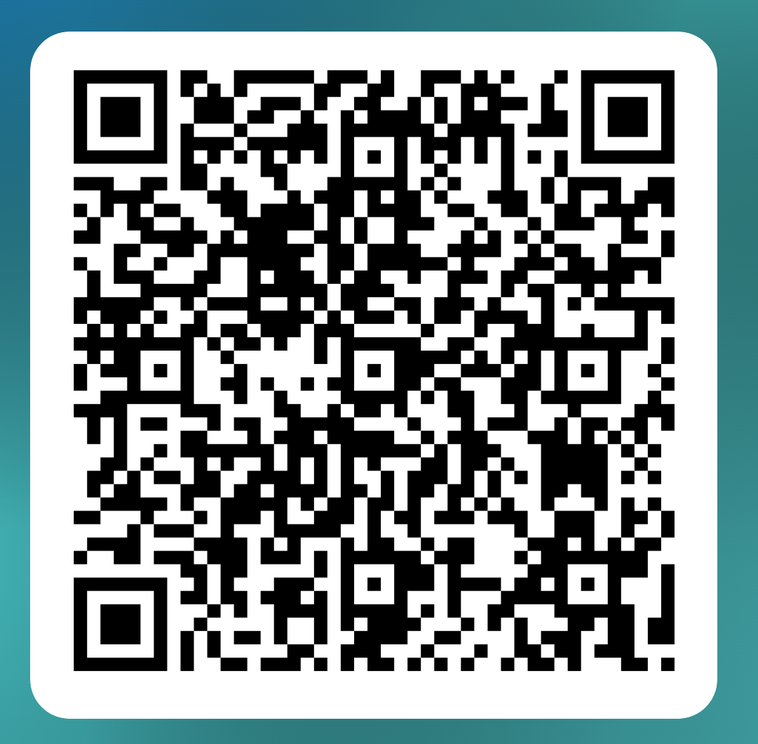
Equality and Diversity Monitoring Form 2026/27
STUDENT LEADER CONFERENCE

