Slide 1


Slide 2
Contents
What is academic representation?
Course Rep responsibilities
Key skills
Signposting
Specialisms
Collecting and sharing feedback
Staff-Student Action Meetings
Support
Key contacts
Next steps

Slide 3
What is Academic Representation?
RHSU definition:
“The purpose of academic representation is to achieve positive change that improves the educational experience of students at Royal Holloway University and engages students as partners in the development, assurance and enhancement of their learning.”

Slide 4
What is Academic Representation?
Academic representation at Royal Holloway has four levels.
Each level of representation has specific responsibilities and duties to make sure the system is as effective as it can be.
Each level feeds into the one above it, and vice versa, to ensure a constant flow of information from one end of campus to the other.
Notes:
Your role as academic reps is to amplify student voice and take students feedback on board to help improve the academic experience at the university

Slide 5
Recent changes to the structure
The Students’ Union has been working towards improving the current academic representation structure which means changes are being implemented from this year.
Last year, Senior Course Reps replaced the Department Rep role to bridge the gap between Course and School Reps and this will remain the same for 2023//24.
Senior Course Reps are uncapped which means there can be more than one per department and level of study. This change aims to provide more points of contact for students, Course Reps and academic staff and allows reps to share responsibilities.
Vice President Education
School Reps
Senior Course Reps
Course Reps

Slide 6
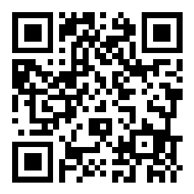
Your role as a Course Rep & Key Skills
As a Course Rep, you should have:
Excellent communication skills
An ability to listen and effectively represent students’ views
A basic understanding of education policy issues
A commitment to diversity, equality and inclusion
Strong relationships with students, University staff and the Students’ Union
Some of the key skills you will develop:

Slide 7
Your role as a Course Rep & Key Skills
As a Course Rep, you should have:
Excellent communication skills
An ability to listen and effectively represent students’ views
A basic understanding of education policy issues
A commitment to diversity, equality and inclusion
Strong relationships with students, University staff and the Students’ Union
Some of the key skills you will develop:
Teamwork
Leadership
Strategic thinking
Decision making
Problem solving
Delegation

Slide 8
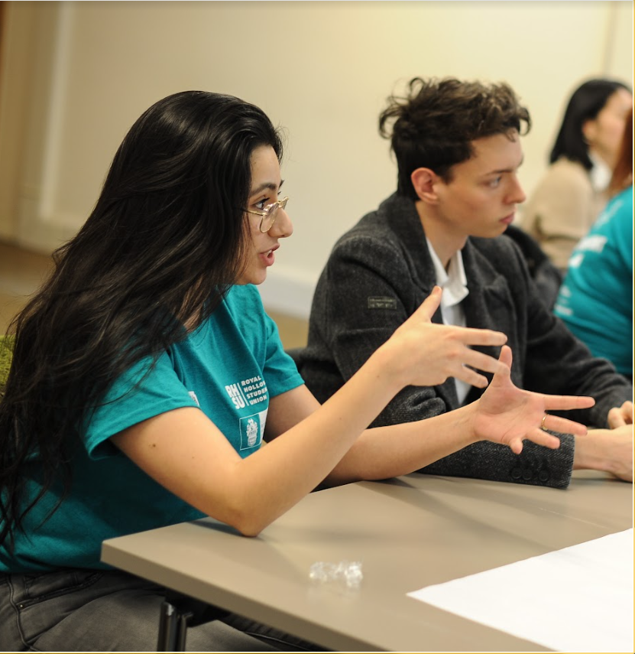
Course Rep Responsibilities
Attending, and contributing to, Staff-Student Action Meetings for your department and level of study.
Gathering feedback from students in your department and passing it onto Senior Course Reps and department staff
Working alongside, and maintaining relationships with, academic staff in your department.
Maintaining relationships with School Reps, VP Education and the SU Student Voice Team
Escalating issues when relevant
Don’t forget that you are not responsible for looking after students’ wellbeing but you can help to support them and guide them in the direction of someone who is trained and qualified to give support and advice.

Slide 9
Signposting
University Wellbeing - The team are not a crisis service but do provide mental healthcare to students who require support.
• Main contact- wellbeing@royalholloway.ac.uk
• Term-time drop-ins available – see the student intranet for joining information
• Counselling service – counselling@royalholloway.ac.uk
• Mental Health practitioners – mentalhealth@royalholloway.ac.uk
• Disability and Neurodiversity Support service- disability-dyslexia@royalholloway.ac.uk
• Financial Wellbeing team – moneymatters@royalholloway.ac.uk
• Multifaith Chaplaincy – chaplaincy@royalholloway.ac.uk
• International Advice team- internationaladvice@royalholloway.ac.uk
• Careers Service – careers@royalholloway.ac.uk
Students’ Union Advice Centre
Email us at advice@su.rhul.ac.uk
See online advice at www.su.rhul.ac.uk/advice

Slide 10
Specialisms
Specialisms were created last year to help empower reps from diverse backgrounds to utilise their own experiences.
BAME
EU/International
Mature
Disabled
LGBT+
Commuting
The aim of specialisms is to enable these students to enact change and offer a specialist perspective due to their lived experience.
This year, you will be able to specialise in one or more of the following areas of student experience:

Slide 11
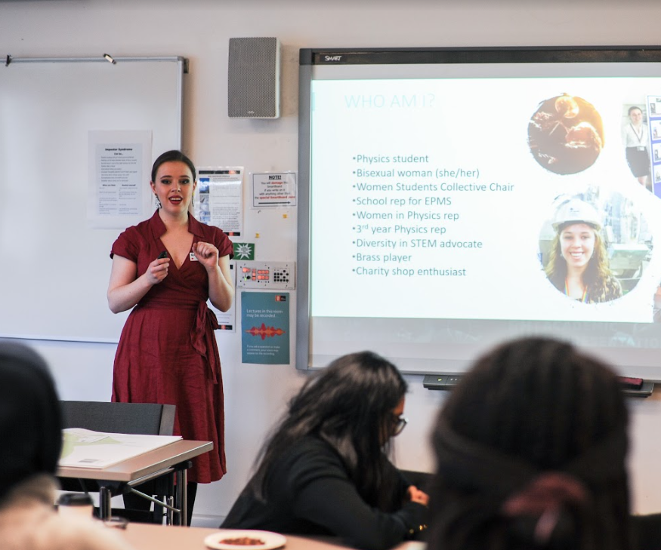
How do specialisms work?
The SU will make staff in your academic department aware that you have chosen a specialism and which one(s) you choose.
If there are any projects that are taking place in the department then staff might contact you and invite you to share your perspective and feedback if you feel comfortable.
This might be relevant for any equality, diversity and inclusion (EDI) projects taking place.

Slide 12
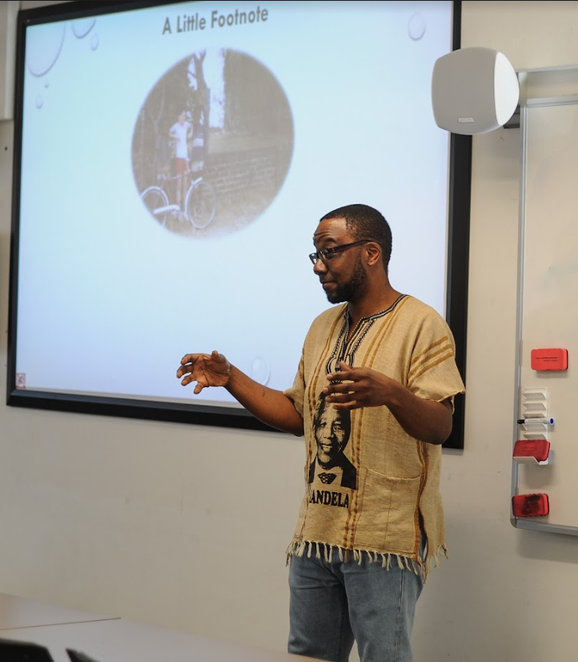
Specialism expectations
As a rep, it’s important for you to gather feedback from students but you are also welcome to talk about your own personal experiences in departmental meetings.
Just because you specialise, doesn’t mean you can only talk about that area. You are still an academic rep so you can do the same work as reps who don’t specialise as well!
Don’t forget that the Course Rep role is voluntary so make sure you set your expectations with your department about how much time you’d like to input to any specialism related work.

Slide 13





Collecting Feedback
There are several ways of collecting feedback and there are likely to be some that you prefer to use over others.
Which methods of feedback collecting can you think of?

Slide 14
Collecting Feedback
You could try:
Talking informally to students and other course reps
Hosting drop in sessions or focus groups
Using social media groups
Giving classmates 5 minutes at the start or end of class
Creating a survey/poll and asking School admin to circulate
Using a physical feedback box
Feedback form provided by the Students’ Union
Remember that effective representation should be accurate, constructive and depersonalised!

Slide 15
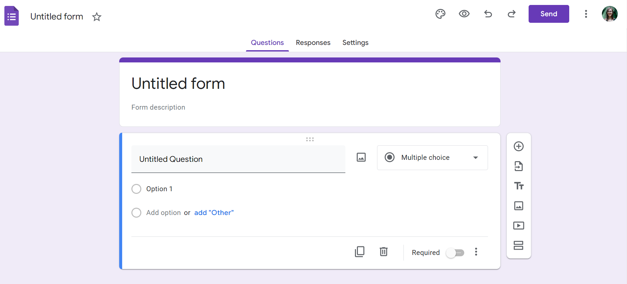
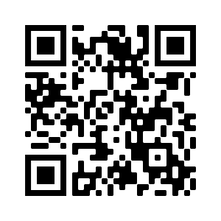
Google Forms
www.google.co.uk/forms/about/
Notes:
Here’s an example of how you might want to gather student feedback/opinions. If you create a blank form on Google Forms and you create your own survey. You can use the QR code on screen to access Google Forms, although you will need to log-in with Google. You can give the survey a title and description and then input questions, either multiple choice or free text answers. You can then see everyone’s responses. If you made a survey you may want to circulate it in your year groups chats, email it to other academic reps or email your School admin team or Head of Department and ask them to circulate it to all the students within your department.

Slide 16
Sharing Feedback
Collect feedback from students
Share with Senior Course Reps and department staff and identify a solution
If the issue impacts the whole school, share with School Rep
School Rep will share with VP Education & Student Voice Team at the SU
Issue can be escalated to College if necessary but if not, a solution will be identified
Issue is acted upon, change is made and you feedback solution to impacted students

Slide 17
Feedback Loop
As a Course Rep, communication is key when collecting feedback to help close the feedback loop.
The feedback loop follows this structure:
Reps gather feedback from students
Reps ensure something is done to create positive change
Reps tell students what has been done with their feedback

Slide 18
Staff-Student Action Meetings
This system ‘Staff-Student Action Meetings’ (SSAM) is being introduced across all 6 schools and all levels of study in September 2023.
Course Reps and Senior Couse Reps attend the SSAM meeting for their department and level of study at least once per term and identified key members of staff should also be present.
Course Reps should speak to students ahead of the meeting and gather any feedback they have that they would like to raise. They should collate the feedback in a specific feedback form which you can find a template of on the Rep Hub. They will then liaise with Senior Course Reps in their department to make them aware of the issues and what is going to be discussed in the meeting.
Senior Course Reps send all feedback to an identified member of staff at least two weeks ahead of the meeting who will add each point onto the agenda for the meeting.
The identified member of staff should invite all attendees (Course Reps, Senior Course Reps, and staff) with plenty of notice and include important details such as time, date, and location along with the agenda and any other useful documents.
At Undergraduate and Postgraduate Taught levels of study, one Senior Course Rep will chair the meeting and at Postgraduate Research, a Course Rep will chair.

Slide 19
Staff-Student Action Meetings
In the meeting, the chair should go through each agenda point and invite attendees to discuss the issue and identify solutions to create positive change for the students who originally raised the feedback.
Staff will have the opportunity to update reps on developments happening behind the scenes that may be useful for them to know.
Identified members of staff and Senior Course Reps will record identified actions which need to be completed as part of the ‘Staff-Student Action Log’.
These logs are a live document which are to be hosted in an individual department MS Teams channel which will be created by the Students’ Union Voice Team and accessible to all students in that department and level of study. This is so that students who don’t attend SSAM can still see what is being discussed and how their feedback is being acted upon.
Although SSAMs are a great way of providing feedback to your department, you are still encouraged to raise student feedback outside of these meetings if necessary.
In agreement with the Students’ Union, Department staff may choose to adapt the model so it works as best as it can for their individual department.

Slide 20
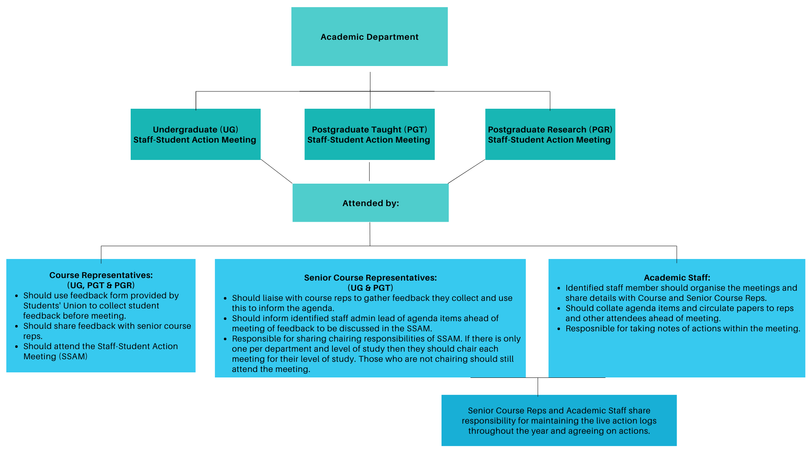
Staff-Student Action Meetings

Slide 21
Recognition
PHOTO SLIDE WITH TEXT
Each month, the submissions will be reviewed and the VP Education will select someone to be recognised as Rep of the Month based off the your impact submissions we receive.
Rep of the Month winners will have a Q&A with VP Education and they will get their own news article on the SU website as well as a section dedicated to them in the monthly rep newsletter.
If there is something you have done that you want to share with the SU then you can add a ‘your impact’ submission to let us know.
‘Your Impact’ and ‘Rep of the Month’ are great ways to shout about your achievements as a rep.
Notes:
All information and forms can be accessed via the SU website

Slide 22
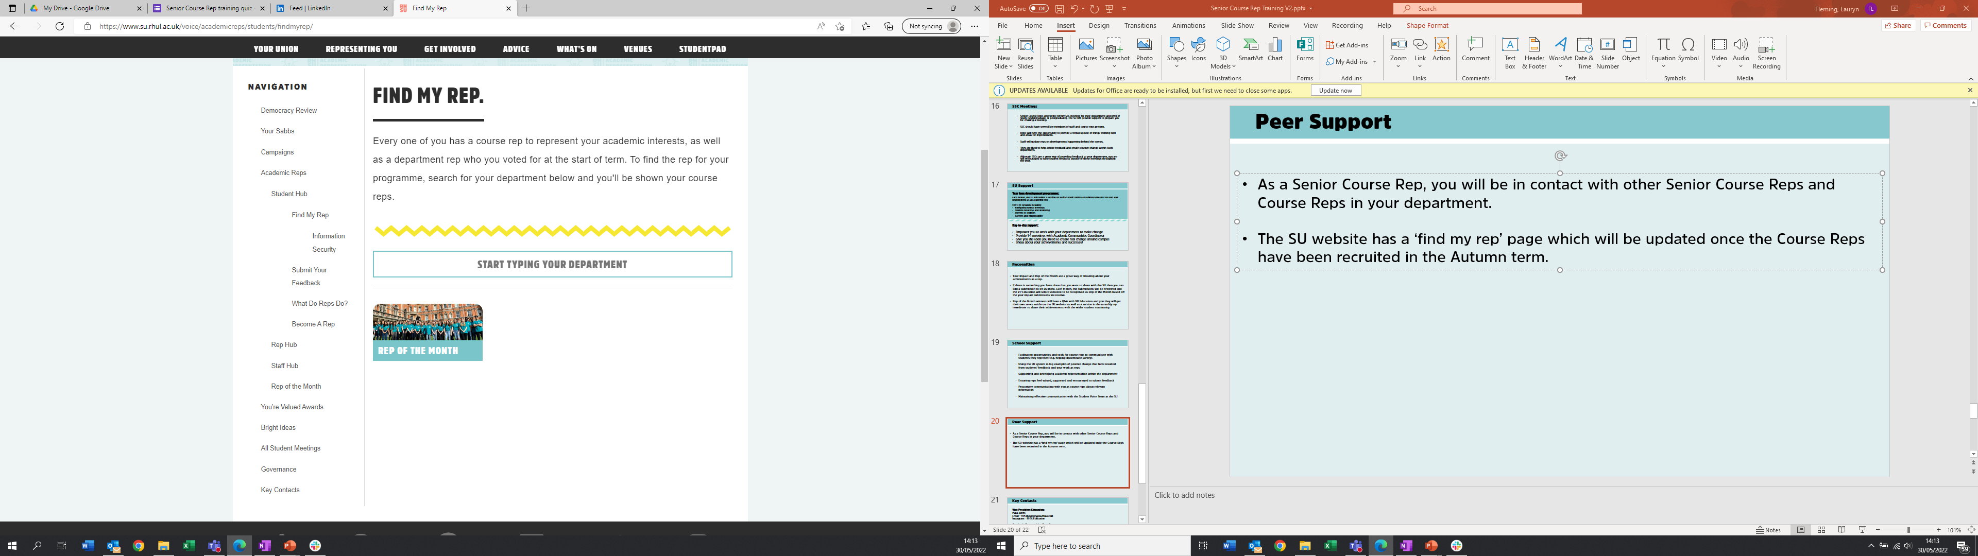
Peer Support
PHOTO SLIDE WITH TEXT
As a Course Rep, you will regularly be in contact with other Course Reps and Senior Course Reps in your department throughout the year.
The SU website has a ‘find my rep’ page which will be updated after training has been completed.
Just type in your department and you will find the names of the reps, their role, course and year of study.

Slide 23
SU Support
Year long development programme:
Each term, the SU will deliver sessions on various topics which are tailored towards you and your development as an academic rep.
Last year’s sessions included
Navigating a typical formal meeting
Mental health awareness
Current issues in Higher Education
Dealing with feedback
Career and employability support
Day-to-day support:
Empower you to work with your department to make change
Provide support from/ 121 meetings with Academic Communities Coordinator
Give you the tools you need to create real change around campus
Send monthly rep newsletters directly to you
Shout about your achievements and successes!

Slide 24
School Support
PHOTO SLIDE WITH TEXT
Facilitating opportunities and tools for Course Reps to communicate with students they represent e.g. helping circulate surveys
Supporting and developing academic representation within the department
Ensuring reps feel valued, supported and encouraged to submit feedback
Proactively communicating with you as Course Reps about relevant information
Maintaining effective communication with the Student Voice Team at the SU

Slide 25
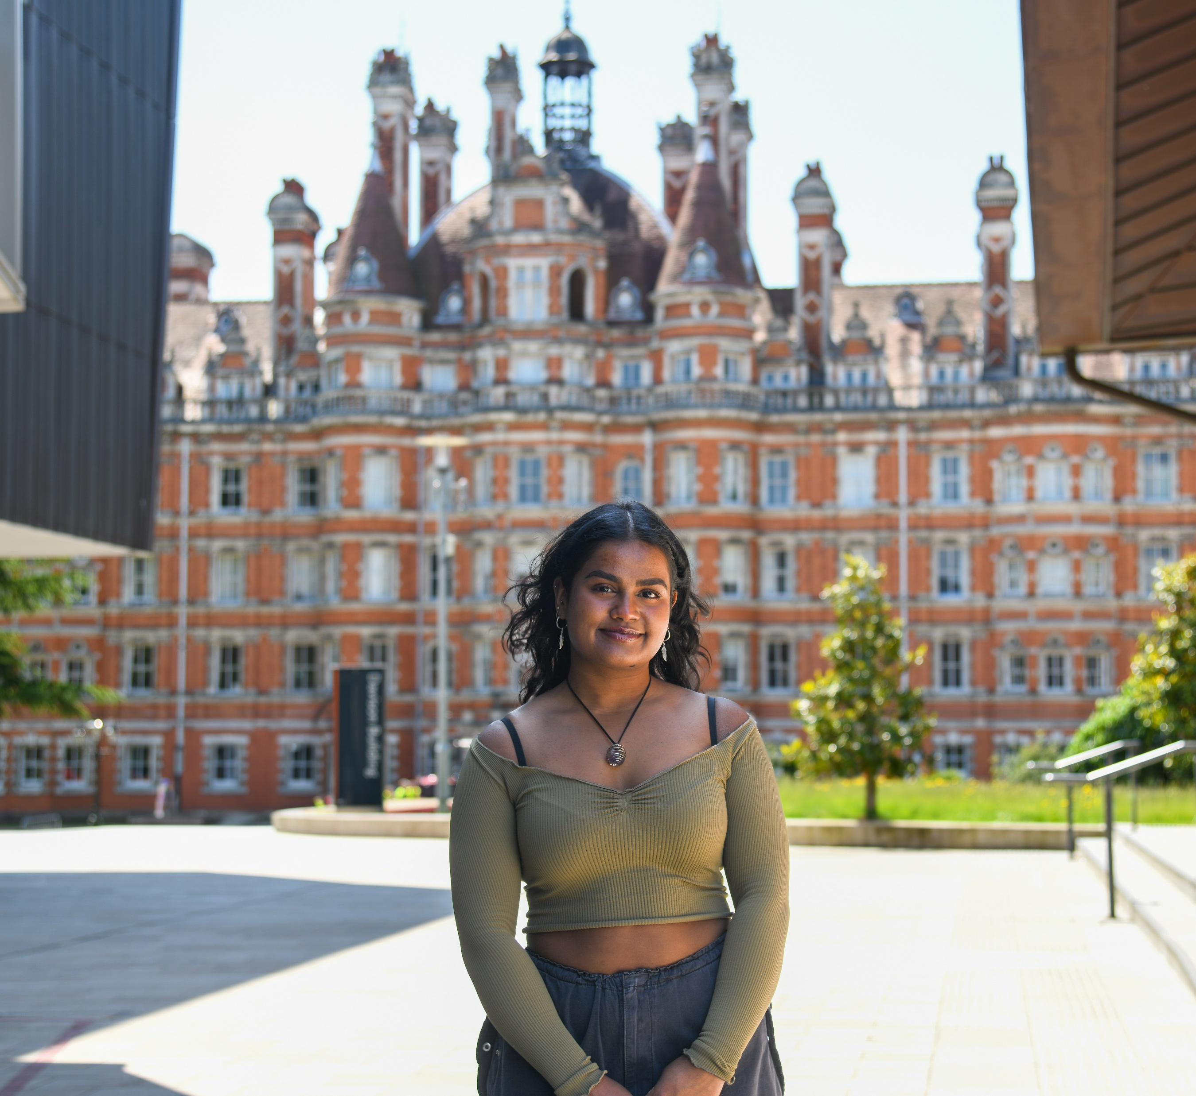
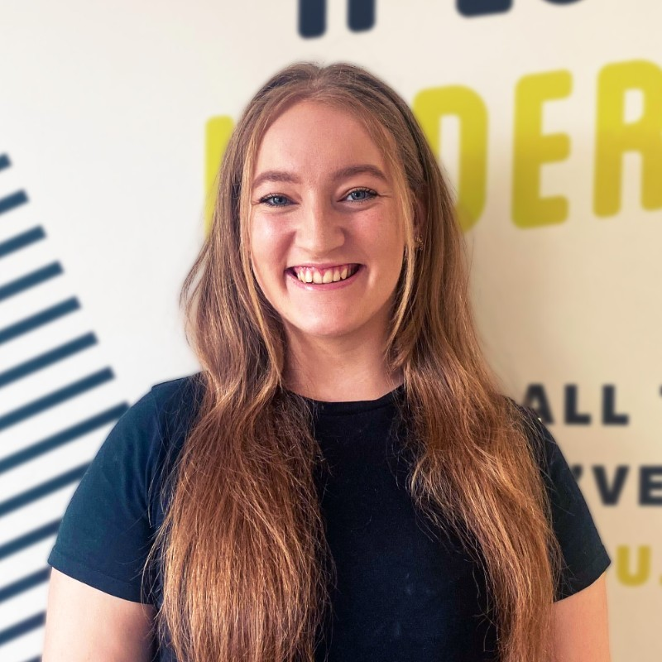
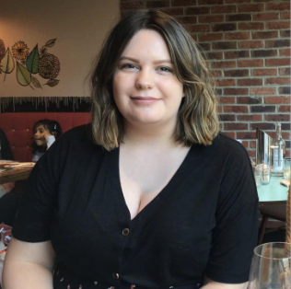
Key Contacts
Vice President Education Academic Communities Coordinator Student Voice Manager
Sharanya Sivarajah
Email - VPEducation@su.rhul.ac.uk
Instagram - RHSUEducation
Lauryn Fleming
Email – lauryn.fleming@su.rhul.ac.uk
Laura Black
Email – laura.black@su.rhul.ac.uk
Student Voice Team:
Email - Voice@su.rhul.ac.uk
Head of Department & Course Convenors

Slide 26

QUIZ – Test your knowledge on all things academic representation
QUIZ

Slide 27
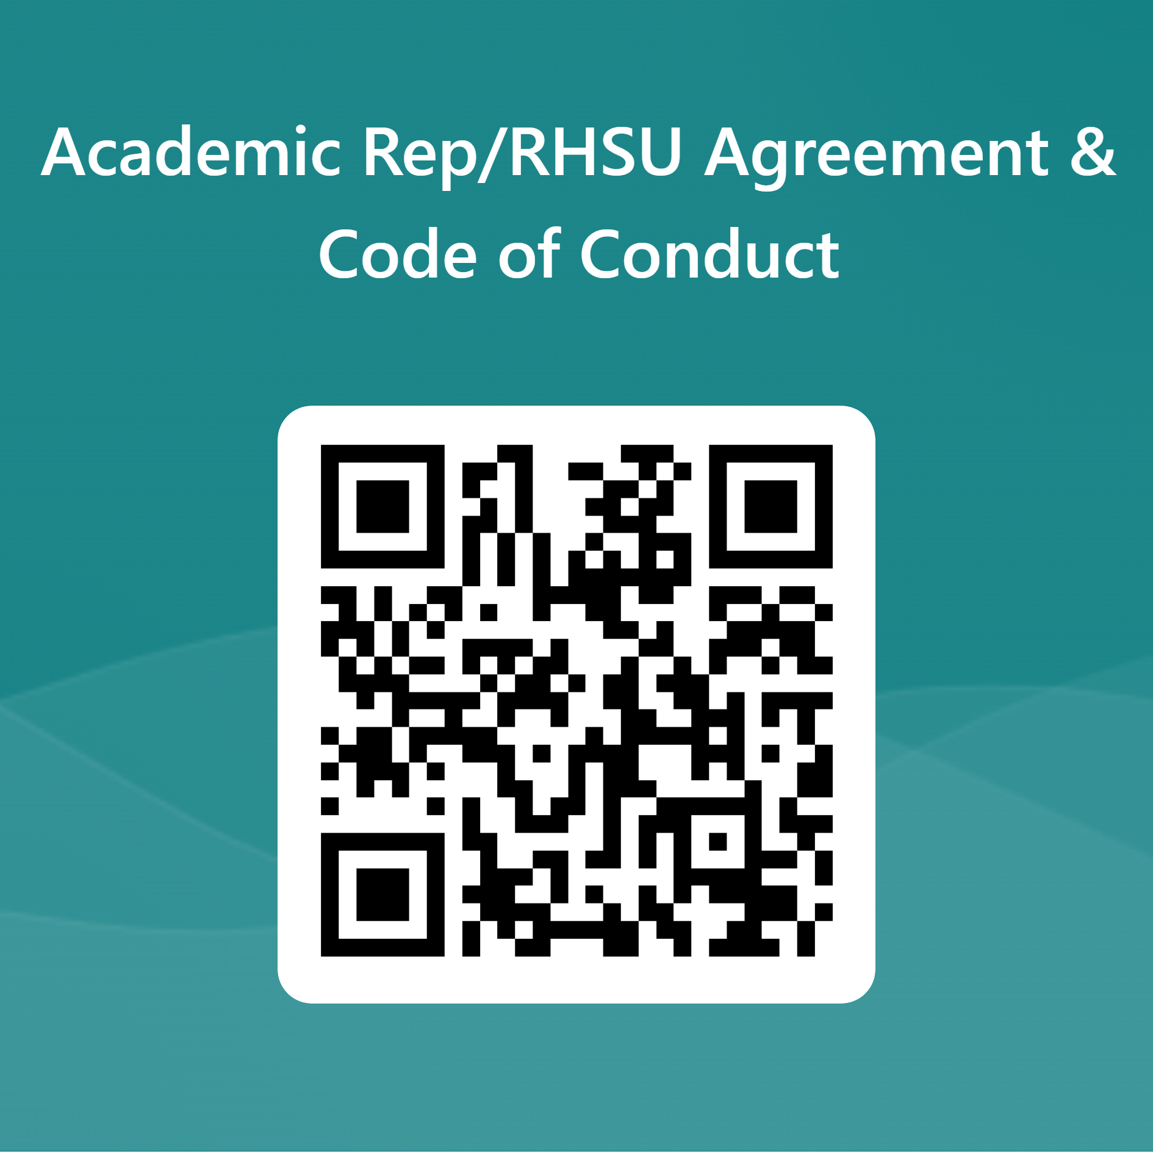
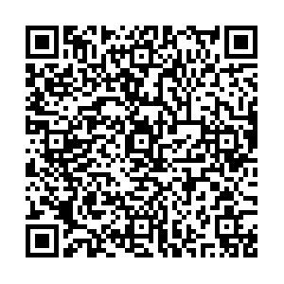
Next Steps
Please also follow this link - Academic Rep Sign Up (rhul.ac.uk), read the documents and scan this QR code to confirm you have read and understood them -
If you haven’t already completed the diversity monitoring form, please make sure you do by scanning this QR code:

Slide 28
Notes:
Questions?

