Slide 1

STUDENT OPPORTUNITIES
COUNCIL
07/02/2019

Slide 2
AGENDA
WHAT IS COUNCIL? WHAT DO I GAIN?
SABB UPDATE: DOM
SABB UPDATE: HOLLY
ITEMS TO DISCUSS
MOTIONS
TIME TO SHOUT ABOUT YOUR EVENTS
AOB
1
STUDENT OPPORTUNITIES COUNCIL

Slide 3

What is a Council? What do I gain?
2
Student Opportunities Council

Slide 4

SABB UPDATE: DOM
1
ALUMNI SPORTS DAY
2
KIT TENDER
3
VARSITY
4
VARSITY PROMOTION VIDEO
5
COLOURS BALL & TRAINING
6
FIGHT NIGHT
7
SUMMER BALL
8
SPORTS LOCK-UP
9
DISABILITY SPORTS DAY
3
Student Opportunities Council

Slide 5
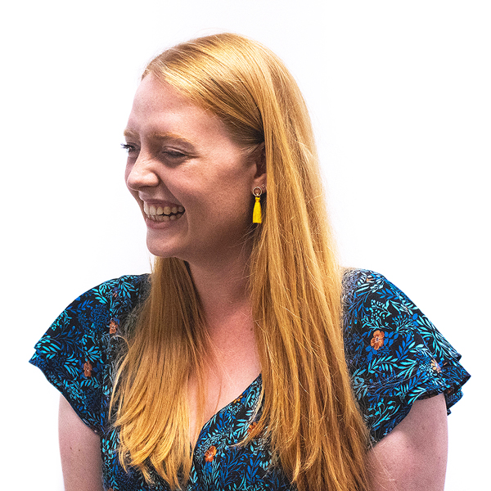
SABB UPDATE: HOLLY
1
RE-FRESHERS
2
RATIFICATIONS
3
SOCS BALL/ TRAINING
4
BYELAW H UPDATE
5
ACADEMIC SOCIETIES
6
MEMORIAL
7
SU/GROUP ELECTIONS
8
DEMOCRACY REVIEW
9
MALE MENTAL HEALTH CAMPAIGN/ TRAINING
4
Student Opportunities Council

Slide 6
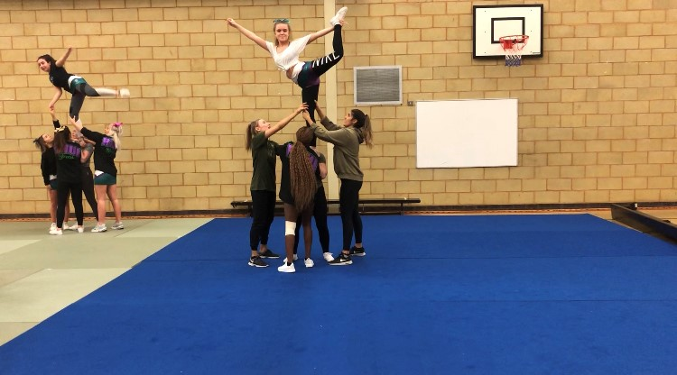
New Group/Group Development Fund
5
Student Opportunities Council

Slide 7
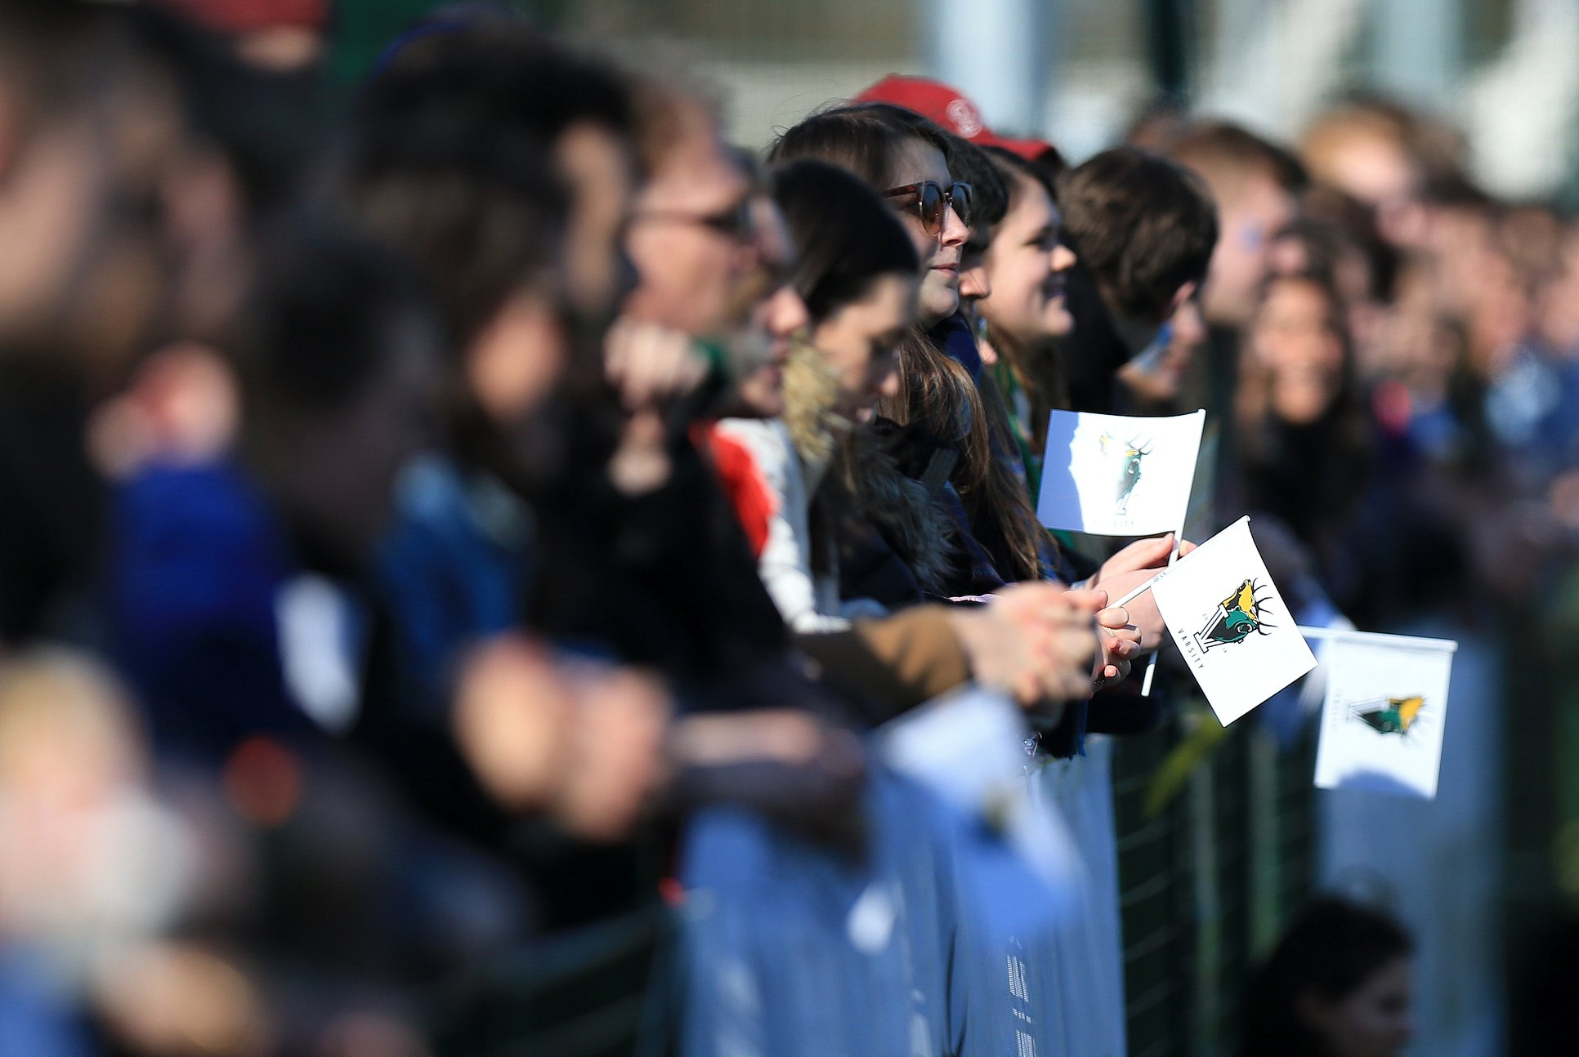
Varsity
6
Student Opportunities Council

Slide 8
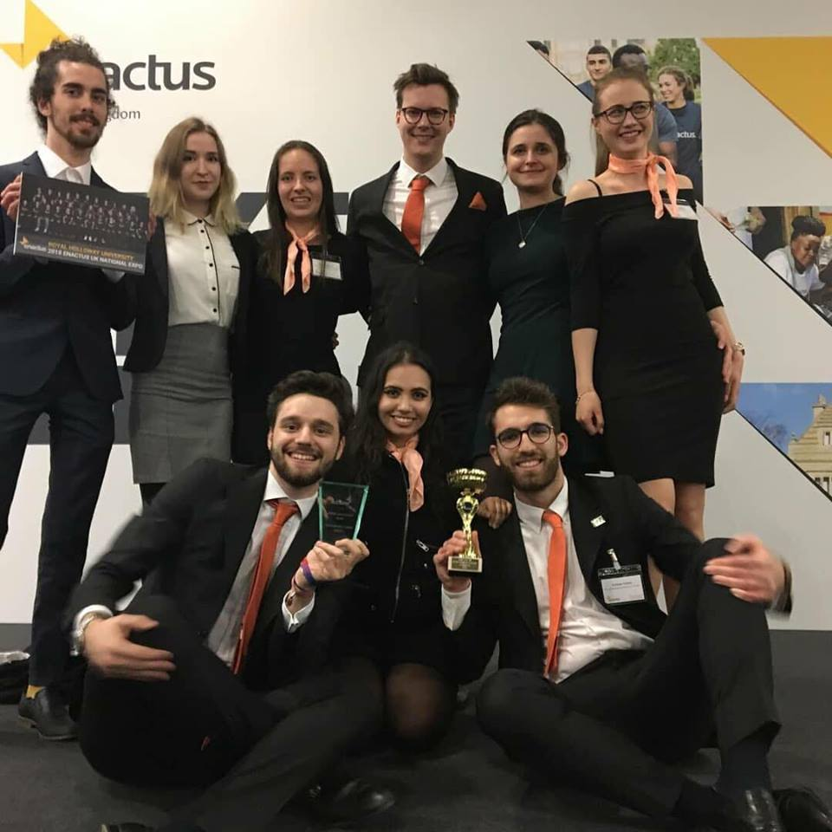
Democracy Review
- An update on the review and what has happened?
What is happening next?
How will we be working with students?
10
Student Opportunities Council

Slide 9

RAG Motion
10
Student Opportunities Council

Slide 10

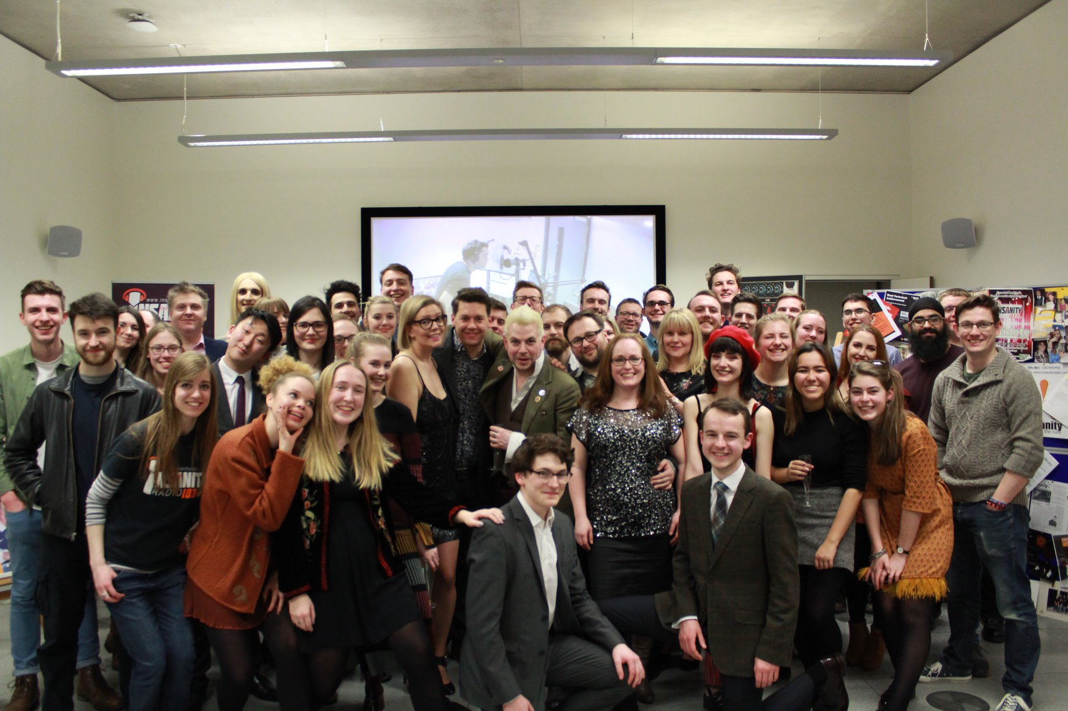
Your Events
7
Student Opportunities Council

